Slide 1
What is the Bill of Rights and What Does it Protect? Lesson 9, Unit 2

Slide 2
1st Amendment
“Congress shall make no law respecting an establishment of religion, or prohibiting the free exercise thereof; or abridging the freedom of speech, or of the press; or the right of the people peaceably to assemble, and to petition the government for a redress of grievances.”

Slide 3
Freedoms in the 1st Amendment
Religion has two parts!
Establishment
Free Exercise
Congress shall make no law respecting an establishment of religion, or prohibiting the free exercise thereof; or abridging the freedom of speech, or of the press; or the right of the people peaceably to assemble, and to petition the government for a redress of grievances.

Slide 4
Freedom of Religion The Establishment Clause
Turn and Talk:
What does it mean to establish a religion?
What might the government do to establish a religion?
Use your imagination!

Slide 5
Freedom of Religion The Establishment Clause
Prohibits the government from making any law “respecting an establishment of religion.”
Forbids the government from creating an official religion AND
Prohibits government actions that unduly favor one religion over another

Slide 6
Freedom of Religion The Free Exercise Clause
Prohibits the government from interfering in people’s ability to believe in a religion of their choice, or no religion at all.
While freedom to believe is absolute, freedom to act is limited.

Slide 7
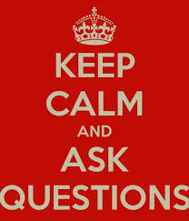
Freedom of Religion The Free Exercise Clause
Why is there a distinction between beliefs and actions?
How does this connect to the fundamental constitutional principle of inalienable rights/social compact?

Slide 8
1st Amendment: Freedom of Religion
Establishment Clause: The Government Cannot Establish a Religion
Free Exercise Clause: The Government Cannot Prohibit You From Believing in a Particular Religion
Question: Why do you think both clauses are needed to protect religious freedom?

Slide 9
1st Amendment Protects Speech
The government cannot restrict people’s right to speak freely or express themselves.
Stop and Jot Questions:
What constitutes speech? (Hint: Think about the ways you share your thoughts and feelings with others).
Why is some speech protected (e.g. speaking out against political policy, political candidates, and/or political ideas) and some is not protected (e.g. threatening a candidate with violence)?
Again, the right to free speech has limits!

Slide 10
1st Amendment Protects Freedom of the Press
The government cannot restrict the right to obtain and publish ideas.
This amendment protects citizens from overbearing government censorship of written or published ideas.

Slide 11
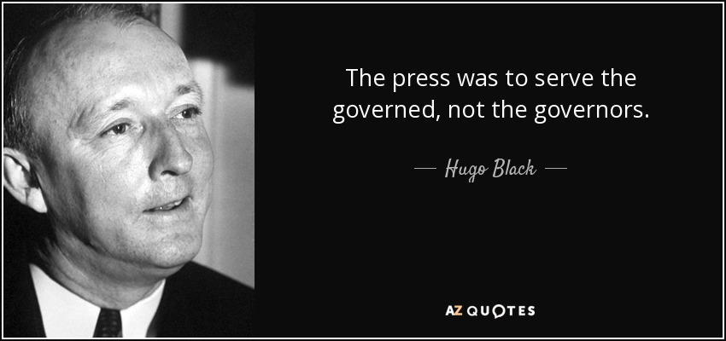
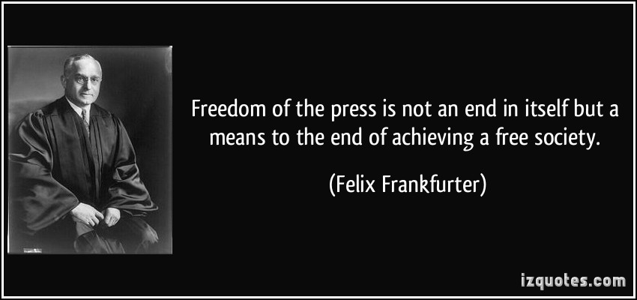
The basis of our government being the opinion of the people,. . . ; and were it left to me to decide whether we should have a government without newspapers, or newspapers without a government, I should not hesitate a moment to prefer the latter. But I should mean that every man should receive those papers and be capable of reading them.
-- Thomas Jefferson, Letter to Colonel Edward Carrington, Jan. 16, 1787
11
Respond on your handout:
5. What do these three quotes have in common? Explain.
Thomas Jefferson, Letter to Colonel Edward Carrington (16 January 1787) Lipscomb & Bergh ed. 6:57.

Slide 12
The First Amendment
Congress shall make no law respecting an establishment of religion, or prohibiting the free exercise thereof; or abridging the freedom of speech, or of the press; or the right of the people peaceably to assemble, and to petition the government for a redress of grievances.
Click Here to see the First Amendment in Action!

Slide 13
1st Amendment Protects Assembly and Petition
Government cannot restrict:
The right of people to peacefully assemble or join groups (associate)
The right of people to ask government to change or do something (petition)
Congress shall make no law respecting an establishment of religion, or prohibiting the free exercise thereof; or abridging the freedom of speech, or of the press; or the right of the people peaceably to assemble, and to petition the government for a redress of grievances.

Slide 14
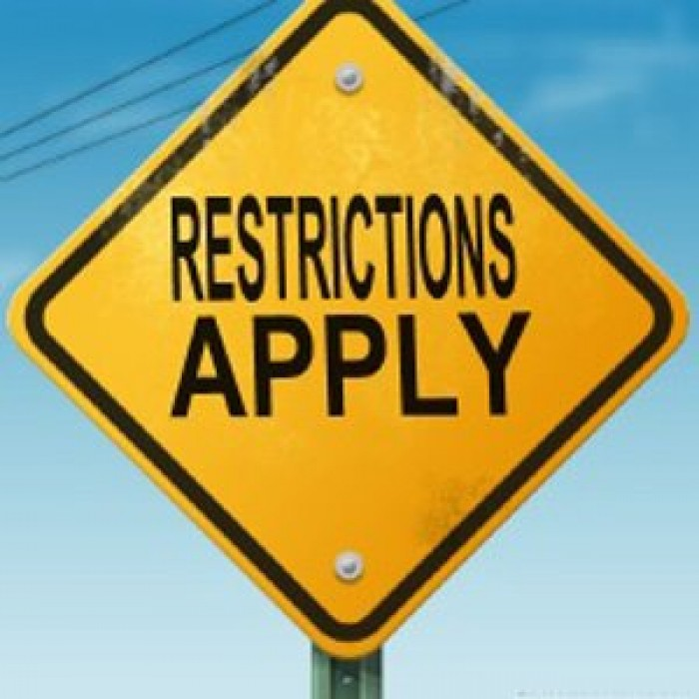
But, all rights have limits!
1st Amendment Freedoms
Religion
Speech
Press
Assembly
Petition

Slide 15
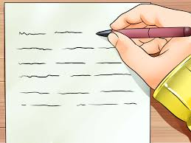
Why is the 1st Amendment essential to our democracy? Write your answer in your notebook!

Slide 16
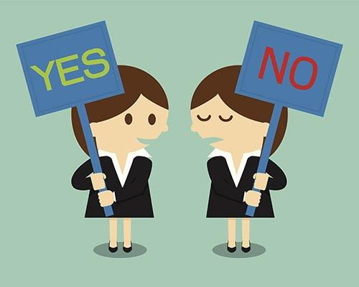
2nd Amendment
Discussion Questions
1. Who has the right to keep and bear arms?
State militias?
Individuals?
Both?
2. What kind of arms are permissible?
“A well regulated militia, being necessary to the security of a free state, the right of the people to keep and bear arms, shall not be infringed.”

Slide 17
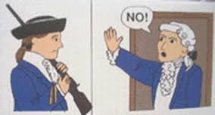
3rd Amendment
“No soldier shall, in time of peace be quartered in any house, without the consent of the owner, nor in time of war, but in a manner to be prescribed by law.”
Freedom from government forcing people to house and feed soldiers in their dwellings in times of peace.

Slide 18
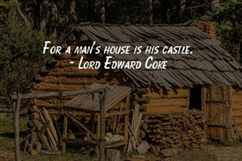
4th Amendment
“The right of the people to be secure in their persons, houses, papers, and effects, against unreasonable searches and seizures, shall not be violated, and no warrants shall issue, but upon probable cause, supported by oath or affirmation, and particularly describing the place to be searched, and the persons or things to be seized.”
No Evidence/ Hunch
Probable Cause
Beyond a Reasonable Doubt

Slide 19
4th Amendment
Protects individual freedom from unreasonable searches and seizures
Government warrants require probable cause
Warrants must be specific

Slide 20
5th Amendment
No person shall be held to answer for a capital or otherwise infamous crime unless on a presentment or indictment of a grand jury, except in cases arising in the land or naval forces, or in the militia, when in actual service in time of war or public danger; nor shall any person be subject for the same offense to be twice put in jeopardy of life or limb; nor shall be compelled in any criminal case to be a witness against himself, nor be deprived of life, liberty, or property without due process of law; nor shall private property be taken for public use without just compensation.

Slide 21
5th Amendment - Rights of the Accused
Freedom from arbitrary arrest - A grand jury must agree that there is evidence of criminal activity
No double jeopardy - Government cannot put a person on trial for a crime for which he or she has already been tried and found guilty or not guilty.
Freedom from self-incrimination - Government cannot force a person to be a witness against himself or herself
Due Process - Government cannot deny a person his or her life, liberty, or property without going through a court process
Just compensation for government taking - Government cannot take private property for government use without fairly paying the property owner.

Slide 22
6th Amendment
Text of the Amendment
Summary
In all criminal prosecutions, the accused shall enjoy the right to a speedy and public trial, by an impartial jury of the state and district wherein the crime shall have been committed, which district shall have been previously ascertained by law, and to be informed of the nature and cause of the accusation; to be confronted with the witnesses against him; to have compulsory process for obtaining witnesses in his favor, and to have the assistance of counsel for his defense.
Speedy, public trial
Impartial jury in the place where the crime was committed
Information about the accusation
Confronting of witnesses against you
Selection of witnesses in your favor
Assistance of an attorney

Slide 23
7th Amendment
Text of the Amendment
Summary
In suits at common law, where the value in controversy shall exceed twenty dollars, the right of trial by jury shall be preserved, and no fact tried by a jury, shall be otherwise reexamined in any court of the United States, than according to the rules of the common law.
Right to a jury trial in non-criminal cases
Jury determines the facts, not the judge in jury trials

Slide 24
8th Amendment
Text of the Amendment
Summary
Excessive bail shall not be required, nor excessive fines imposed, nor cruel and unusual punishments inflicted.
Rights of the accused and the guilty:
no excessive bail
no excessive fines
no cruel and unusual punishment

Slide 25
8th Amendment
Cruel and unusual punishment is a matter of judgment.
Would this include:
unsanitary, dangerous or overly restrictive living conditions?
solitary confinement?
torture?
the death penalty?

Slide 26
9th Amendment
Text of the Amendment
Summary
The enumeration in the Constitution, of certain rights, shall not be construed to deny or disparage others retained by the people.
The people may have other rights in addition to those listed in the Constitution.

Slide 27
10th Amendment
Text of the Amendment
Summary
The powers not delegated to the United States by the Constitution, nor prohibited by it to the states, are reserved to the states respectively, or to the people.
The federal government only has powers listed in the Constitution
The states or the people keep the rest of the power
Watch this video:
http://content.time.com/time/video/player/0,32068,1026395309001_2080304,00.html

Slide 28
The Bill of Rights protects against whose actions?
What role does the judicial branch play with respect to the Bill of Rights?

Slide 29
The Bill of Rights Protects Individuals from Government Interference!
The Bill of Rights protects against STATE ACTION….
NOT your parents or guardians!!!

Slide 30
Role of the Judicial Branch
Has constitutional and legal authority over cases and controversies
Makes decisions/judgments about what is or is not legal
Upholds the Constitution as the supreme law of the land

