Slide 1
How does government under the Constitution work to protect “We the People” from tyranny?
Lesson 7, Unit 2
1

Slide 2
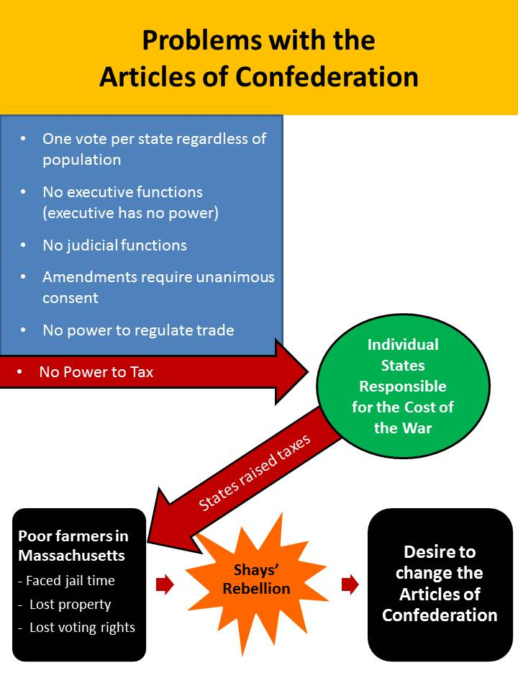
What was the overall problem with the Articles of Confederation?
Too Little Power
2

Slide 3
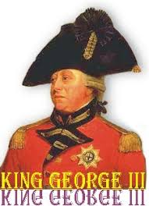
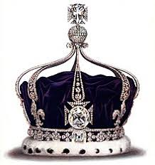
What might be the problem with giving government too much power?
Turn and Talk
3
Notes:
Background on Lord Acton
10 January 1834 – 19 June 1902
He was an English Catholic historian, politician, and writer.
Described as “the magistrate of history,” Lord Acton was one of the great personalities of the nineteenth century and is universally considered to be one of the most learned Englishmen of his time.
He made the history of liberty his life's work; indeed, he considered political liberty the essential condition and guardian of religious liberty.

Slide 4
Power tends to corrupt and absolute power corrupts absolutely
-- Lord Acton
4
Notes:
Background on Lord Acton
10 January 1834 – 19 June 1902
He was an English Catholic historian, politician, and writer.
Described as “the magistrate of history,” Lord Acton was one of the great personalities of the nineteenth century and is universally considered to be one of the most learned Englishmen of his time.
He made the history of liberty his life's work; indeed, he considered political liberty the essential condition and guardian of religious liberty.

Slide 5
How does government under the Constitution work to protect “We the People” from tyranny?
5

Slide 6
Separation of Powers
Article I
Legislative Branch
Legislative Power
The power to make laws
Article II
Executive Branch
Executive Power
The power to enforce laws
Article III
Judicial Branch
Judicial Power
The power to interpret laws
6

Slide 7
Divide the Class into Three Expert Groups
Legislative Branch
Executive Branch
Judicial
Branch
Within each expert group:
Get into pairs or triads
Count off A-E, so that each pair/triad has a letter to correspond with their assigned text
Complete your assigned portion of Handout 2
7

Slide 8
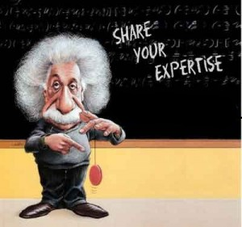
Share Your Findings with your Expert Team
8

Slide 9
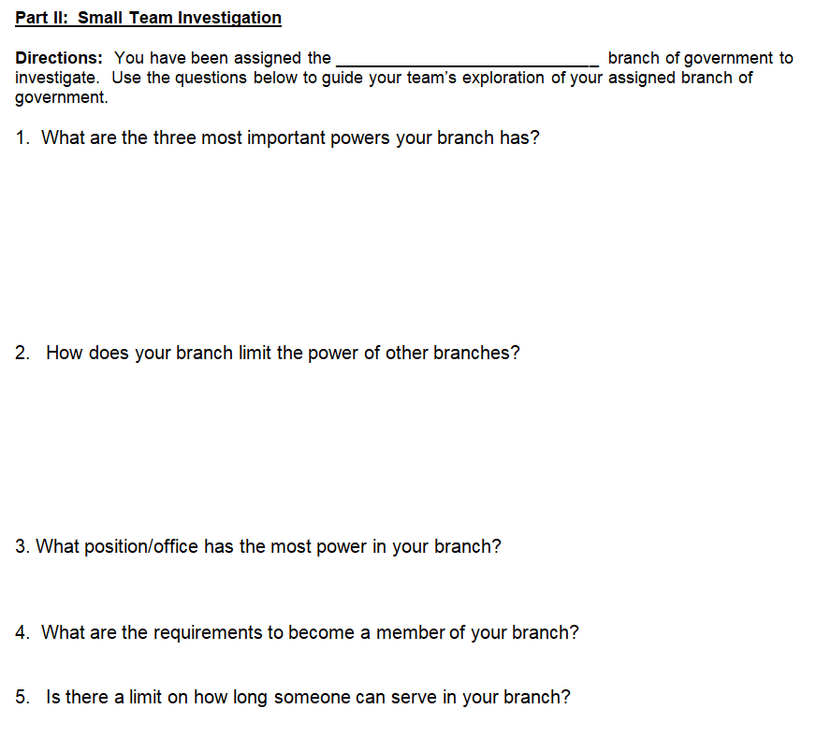
Select a leader to manage the group.
The job of the leader is to help the team arrive at a collective answer by calling on team volunteers to share their thinking.
Record the answers that most of the team agrees with on Handout 1, Part II.
9

Slide 10
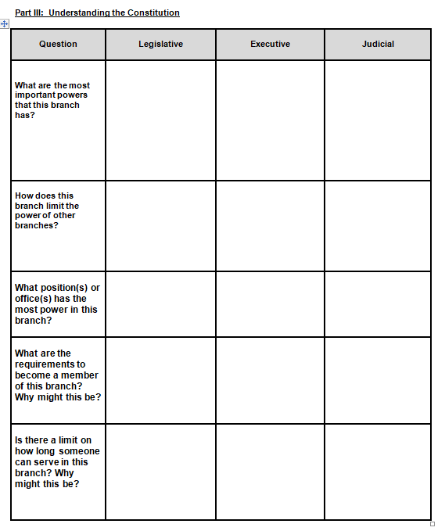
Divide Into Mixed Triads
Each group member should represent a different branch of government
As a newly formed team, complete Part III of Handout 1 in preparation for a fishbowl discussion.
Executive Branch
Judicial Branch
Legislative Branch
10

Slide 11
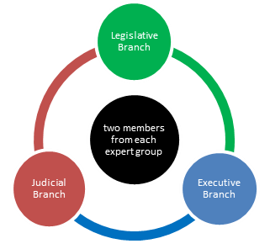
Fishbowl Set Up
11

Slide 12
Stay on Task and on Topic.
Seek First to Understand, Then to be Understood.
One Mic (Speaker) at a Time.
Challenge the Idea, Not the Person.
Be Thoughtful, Courteous, and Kind.
12

