Slide 1
What is the Social Compact in the United States? How do you know?
Unit 2, Lesson 6: How does the Preamble to the U.S. Constitution establish the purposes of our government?
1
1

Slide 2
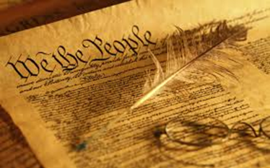
The U.S. Constitution
2

Slide 3
Questions to Consider:
What is the advantage of having a written document containing a plan of government?
How would that help people come to a “meeting of the minds”?
How would a written document protect people?
What might happen in the absence of a written document?
3

Slide 4
Constitution Writing: An Act of Intent
The Framers had to agree on the rules governing the political system and the rights of citizens.
In writing the Constitution, the Framers intended it to:
Be the supreme law
Give certain powers to the government
Limit the powers of government
Ensure the rule of law
Protect popular sovereignty
Because people have inalienable/natural rights, the Framers only delegated certain powers to the government.
4
Notes:
A written constitution includes the rules that govern the political system and the rights of citizens and governments in a codified form.
Outlines the social compact
Explains what power the people give the government
Establishes rules that govern the political system and the rights of citizens

Slide 5
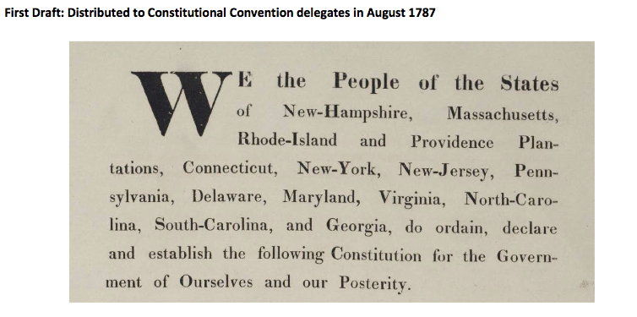
Historical Context
5
Notes:
Share the first draft of the Preamble of the Constitution. Ask for a student volunteer to read it to the class. Ask for class/student observations. This will most likely result in students pointing out the following: All the states are listed, Missing several of the words/objectives of the Preamble
Ask students what might be some problems or why was it re written.
Possible responses may include:
What will happen when we add a state, it is not united, more like the Article of Confederation where states were individuals, etc.

Slide 6
Preamble to the Constitution
We the People of the United States, in Order to form a more perfect Union, establish Justice, insure domestic Tranquility, provide for the common defense, promote the general Welfare, and secure the Blessings of Liberty to ourselves and our Posterity, do ordain and establish this Constitution for the United States of America.
6

Slide 7
How is the Constitution Organized?
Preamble
Articles 1- 7
Amendments
7

Slide 8
Preamble to the Constitution
We the People of the United States, in Order to form a more perfect Union, establish Justice, insure domestic Tranquility, provide for the common defense, promote the general Welfare, and secure the Blessings of Liberty to ourselves and our Posterity, do ordain and establish this Constitution for the United States of America.
Respond in your notebooks:
What does “We the People” mean to you?
8

Slide 9
Historical Context of “We the People”
At the time the Constitution was drafted, not all people were included in this meaning:
Enslaved people
Native Americans
Women
Reflection: How does this compare to what you wrote in your “We the People” journal?
9

Slide 10
SIX GOALS OF THE CONSTITUTION
form a more perfect union
establish Justice
insure domestic Tranquility
provide for the common defense
promote the general welfare
secure the Blessings of Liberty for ourselves and our posterity
10

Slide 11
To Form a More Perfect Union…
Why do you think this was the first goal or purpose?
What might this have to do with the problems under the Articles of Confederation?
11

Slide 12
To Form a More Perfect Union
Historical Context:
The delegates met to revise the Articles of Confederation
Problems under the Articles
Role of Perspective:
Would the problems experienced under the Articles have convinced you to change our system of government? Why or why not?
Why does perspective matter?
12

Slide 13
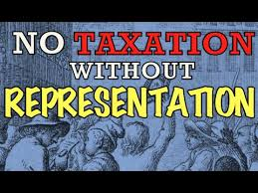
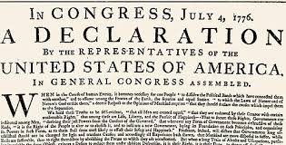
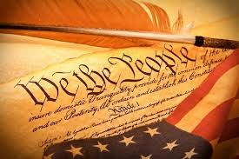
Establish Justice
13
Historical Context:
Justice was on the minds of the delegates since prior to declaring independence.
The Declaration of Independence listed injustices committed against the colonists
The Framers wanted to establish a government that was fair and respected and defended people’s natural rights.

Slide 14
Establish Justice
Our notions of what is just has called into question previous laws and practices.
Examples include slavery, women’s rights, land usage, immigration, gay rights, use of military or police force, etc.
Respond in Writing:
Why might people agree about justice in the abstract, but disagree when applied to a particular situation?
14

Slide 15
Insure Domestic Tranquility
Peace for people within the country and among the states
Example: Disputes between states or groups within the United States which may interfere with trade or disrupt the general harmony of society.
15

Slide 16
Insure Domestic Tranquility
Thinking Historically
1. Why would this have been a concern of the Framers?
2. What historical examples of disruption to trade or society in general have we studied?
16

Slide 17
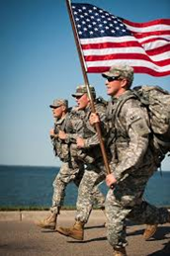
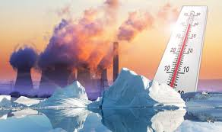
Provide for the Common Defense
Includes both internal and external threats
Essential to the survival of our nation
Some argue that the government should also be protecting against environmental threats that can affect our way of life or our very survival.
18

Slide 18
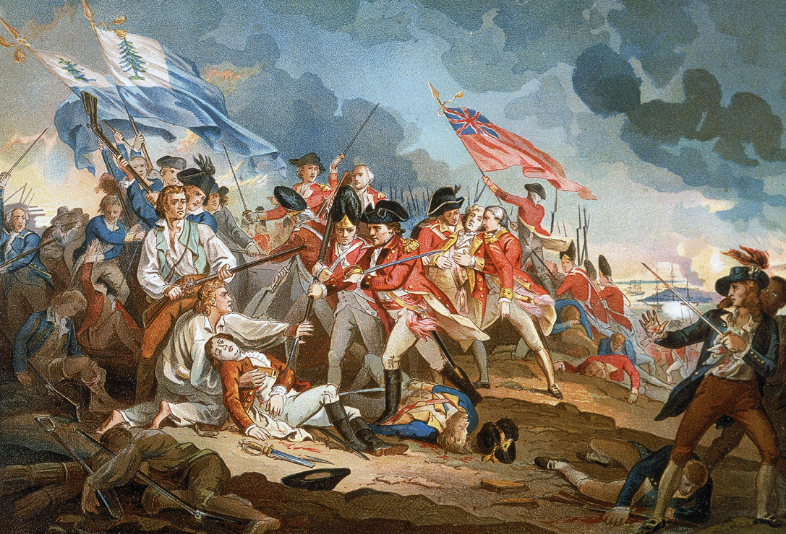
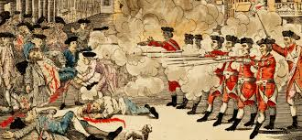
Provide for the Common Defense
Historical Context
Why might this have been important to the Framers?
19

Slide 19
Provide for the Common Defense
Reflect in Writing
Why is military service so important to the nation?
If it is so important, why is it voluntary and not mandatory?
Should some service to the country be required?
20

Slide 20
Promote the General Welfare
What is it?
concern of the government for the health, peace, morality, and safety of its citizens;
not to favor certain groups over others
Why was this on the minds of the Framers?
21

Slide 21
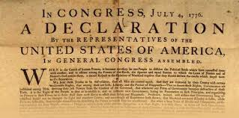
Historical Context of the General Welfare
The Declaration of Independence stated that the British King:
"had refused his assent to laws, the most wholesome and necessary for the public good”
22

Slide 22
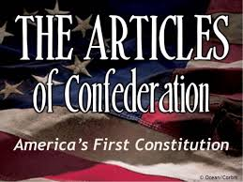
"Art. III. The said states. . . enter into a firm league of friendship . ..for their mutual and general welfare, binding themselves to assist each other, against ... attacks made upon them...."
"Art. VIII. All charges of war, and all other expenses which shall be incurred for the common defense and general welfare ... shall be defrayed out of a common treasury....”
23

Slide 23
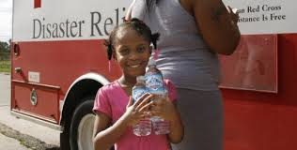
Examples of General Welfare
24

Slide 24
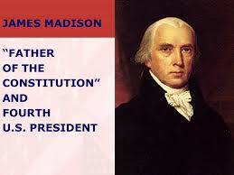
Reflecting on the General Welfare
“If Congress can do whatever in their discretion can be done by money, and will promote the general welfare, the government is no longer a limited one possessing enumerated powers, but an indefinite one subject to particular exceptions.”
QUESTION: How does Madison’s quote help explain why people disagree about what constitutes the general welfare?
25

Slide 25
secure the Blessings of Liberty to ourselves and our Posterity
What does this mean?
26

Slide 26
secure the Blessings of Liberty to ourselves and our Posterity
Discussion Questions
1. For whom were the Framers trying to secure the blessings of liberty?
2. Why do you think the Framers included their “posterity” in the Preamble?
27

Slide 27
We the People of the United States, in Order to form a more perfect Union, establish Justice, insure domestic Tranquility, provide for the common defense, promote the general Welfare, and secure the Blessings of Liberty to ourselves and our Posterity, do ordain and establish this Constitution for the United States of America.
28

Slide 28
Which is MOST important to you? (choose only one)
Justice
2. Security/Safety
3. Providing for the General Welfare
4. Freedom (for us)
5. Freedom (for future generations)
29

Slide 29
Which is LEAST important to you? (choose only one)
Justice
2. Security/Safety
3. Providing for the General Welfare
4. Liberty (for us)
5. Liberty (for future generations)
30

Slide 30
Tensions among our Values
Liberty v. Providing for the Common Good
Our Liberty v. Liberty for Future Generations
Liberty v. Security
Justice = Equal Opportunity v. Competition and Individual Effort
31

Slide 31
When addressing public issues, differences in positions are due to the weight we -- as individuals -- place on particular values over others….
But…. they are all American values!
32

Slide 32
Current Issues
Should there be more restrictive regulations on gun ownership?
Should we ban people from immigrating from certain countries?
Should we allow Nazis or White Supremacists to march in our community?
Should all citizens have a right to health care?
Should a business be able to deny service to a customer if the request conflicts with the owner’s religious beliefs?
33

