Slide 1
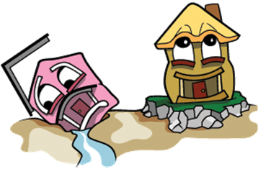
Examining an Image
What do you see?
1

Slide 2
What is a foundation?
an underlying basis or principle for something
Example: The foundation of our government consists of five inherited principles.
2

Slide 3
How did the Framers of the Constitution use inherited principles to create a unique form of government to empower “We the People”? Lesson 5, Unit 2
3

Slide 4
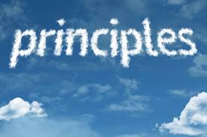
So, what is a principle?
a fundamental truth or proposition that serves as the foundation for a system of belief or behavior or for a chain of reasoning
4

Slide 5
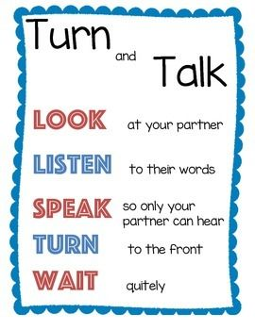
What are the fundamental principles that serve as a foundation for our system of government?
5

Slide 6
Fundamental Constitutional Principles
Inalienable Rights/Social Compact | Popular Sovereignty | Rule of Law | Limited Government | Equality
an individual enters into society with certain basic rights and that no government can deny these rights
individuals willingly surrender some of their natural or inalienable rights in exchange for protection by the society in the form of laws and rules
the authority of government is created and sustained by the consent of its people, who are the source of all political power
People’s right and duty to “alter or abolish” government that acts against the common interest or threatens the safety of the people without cause
all people and institutions must follow the laws, which are fairly applied to everyone
governmental power is restricted by law, usually in a written constitution
the condition of being equal, or the same in quality, measure, esteem or value especially before the law

Slide 7
Comparing Principles and Mechanisms
Principle
a fundamental truth or proposition that serves as the foundation for a system of belief or behavior or for a chain of reasoning
Mechanism
a process or system that is used to produce a particular result
7

Slide 8
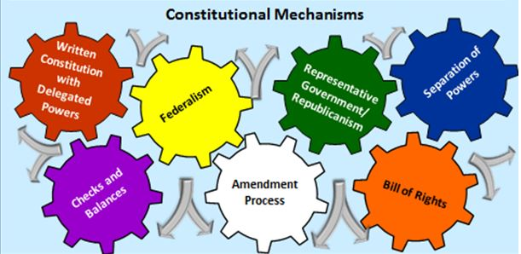
Bring the attention of your audience over a key concept using icons or illustrations
8

Slide 9
Constitutional Mechanism
Written Constitution with Delegated Powers
Definition/Description | Where is it found? | Which foundational principles does this mechanism promote and/or protect?
9

Slide 10
Constitutional Mechanism:
Written Constitution with Delegated Powers
Examples of Delegated Powers Listed in Article I, Section 8:
The Congress shall have Power To lay and collect Taxes…;
To borrow money on the credit of the United States;
To regulate Commerce with foreign Nations, and among the several States, and with the Indian Tribes;…
To coin Money, regulate the Value thereof, …
To establish Post Offices …
To constitute Tribunals inferior to the supreme Court;…
To declare War…
Written Constitution with Delegated Powers
10

Slide 11
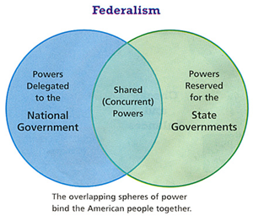
Constitutional Mechanism:
Federalism
Federalism
11

Slide 12
Constitutional Mechanism:
Federalism
The 10th Amendment
“The powers not delegated to the United States by the Constitution, nor prohibited by it to the States, are reserved to the States respectively, or to the people.”
Federalism
12

Slide 13
Constitutional Mechanism:
Federalism
Which constitutional principles does this mechanism protect or promote?
Inalienable Rights/Social Compact?
Popular Sovereignty?
Rule of Law?
Limited Government?
Equality?
Federalism
13

Slide 14
The Task:
Identify a reporter for your group
Discuss the questions below
Be prepared to share your group’s thinking with the whole class.
Small Group Discussion:
How do we describe this mechanism?
Which principles of the constitution does this mechanism protect or promote?
How does this mechanism protect or promote these principles?
14

Slide 15
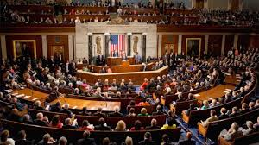
Constitutional Mechanism:
Representative Government/Republicanism
a way for citizens have a voice in their government by electing people to represent their interests and concerns
Example: Elections for House, Senate, and President
Principles Supported:
Inalienable Rights/Social Compact
Popular Sovereignty
Limited Government
Rule of Law
Representative Government/ Republicanism
15

Slide 16
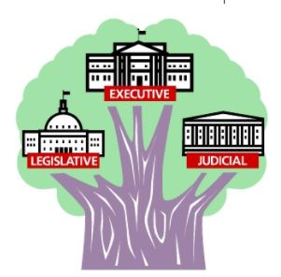
Constitutional Mechanism:
Separation of Powers
a mechanism or constitutional structure that divides powers and responsibilities of government among the legislative, executive, and judicial branches
Examples found in Articles I-III of the Constitution:
Legislative branch has the power to pass laws
Executive branch has the power to execute the laws
Judicial branch has the power to interpret what the law means.
Separation of Powers
Principles Supported:
Limited Government
Rule of Law
16

Slide 17
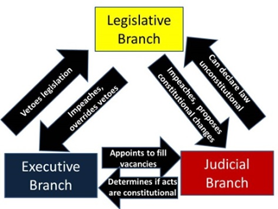
Constitutional Mechanism:
Checks and Balances
A mechanism or constitutional structure that empowers each branch of government (legislative, executive, and judicial) to amend or veto acts of another branch
Principles Supported:
Inalienable Rights/Social Compact
Popular Sovereignty
Limited Government
Rule of Law
Checks and Balances
17

Slide 18
Constitutional Mechanism:
Amendment Process
the method described in the Constitution by which the Constitution can be adapted to changes over time
Example: Article V of the U.S. Constitution provides for an amendment process.
Principles Supported:
Inalienable Rights/Social Compact
Popular Sovereignty
Limited Government
Rule of Law
Equality
Amendment Process
18

Slide 19
Constitutional Mechanism:
Bill of Rights
personal, political, and economic freedoms that are guaranteed from unjustified government interference
Principles Supported:
Inalienable Rights/Social Compact
Popular Sovereignty
Limited Government
Rule of Law
Equality
Bill of Rights
19

Slide 20
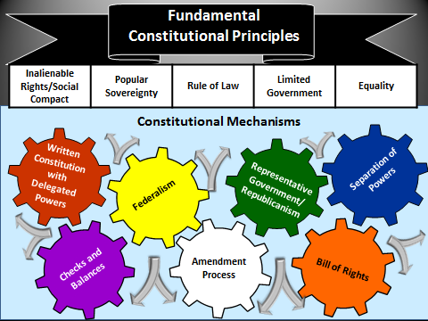
20

Slide 21
Benjamin Franklin on Popular Sovereignty
"In free governments, the rulers are the servants and the people their superiors and sovereigns”
Describe and explain how at least three constitutional mechanisms promote or protect popular sovereignty
Benjamin Franklin (2003). The Political Thought of Benjamin Franklin. Edited by Ralph Ketchum; Hackett Publishing. p. 398.
21

