Slide 1
Is Gerrymandering threatening our constitutional democratic republic? Lesson 10, Unit 2

Slide 2
The Declaration of Independence
“We hold these truths to be self-evident, that all men are created equal, that they are endowed by their Creator with certain unalienable Rights, that among these are Life, Liberty and the pursuit of Happiness.--That to secure these rights, Governments are instituted among Men, deriving their just powers from the consent of the governed…”
Discussion Questions
1. What type of source is this?
(primary or secondary)
2. What is the central idea of the quote?
Notes:
After discussing that they are all excerpts from primary source documents, make sure students discuss that the ideas in the first quote revolve around the central idea. People have rights and form governments to make sure that these rights aren’t violated and that these governments get their power from the authority of the people. In the second quote, be sure students are aware that the power of the government under our Constitution springs from the people. In the third quote, be sure students see that the state legislature is mentioned as having authority over the time, place, and manner of elections for federal representatives and senators. After discussing all three quotes, hold a brief discussion over whether there seems to be any conflict among the ideas expressed in these three quotes. If students struggle to see any conflicts, ask students whether the people get to set the rules for their elections. Some might say no (it’s the state legislatures); some might say that the people do. Allow any disagreement to linger without attempting to resolve it for now.

Slide 3
Fundamental Constitutional Principles
Inalienable Rights/Social Compact | Popular Sovereignty | Rule of Law | Limited Government | Equality
an individual enters into society with certain basic rights and no government can deny these rights
individuals willingly surrender some of their natural or inalienable rights in exchange for protection by the society in the form of laws and rules
the authority of a state and its government is created and sustained by the consent of its people, who are the source of all political power
all people and institutions must follow the laws, which are fairly applied to everyone
governmental power is restricted by law, usually in a written constitution
the state of being equal, especially in status, rights, and opportunities under the law

Slide 4
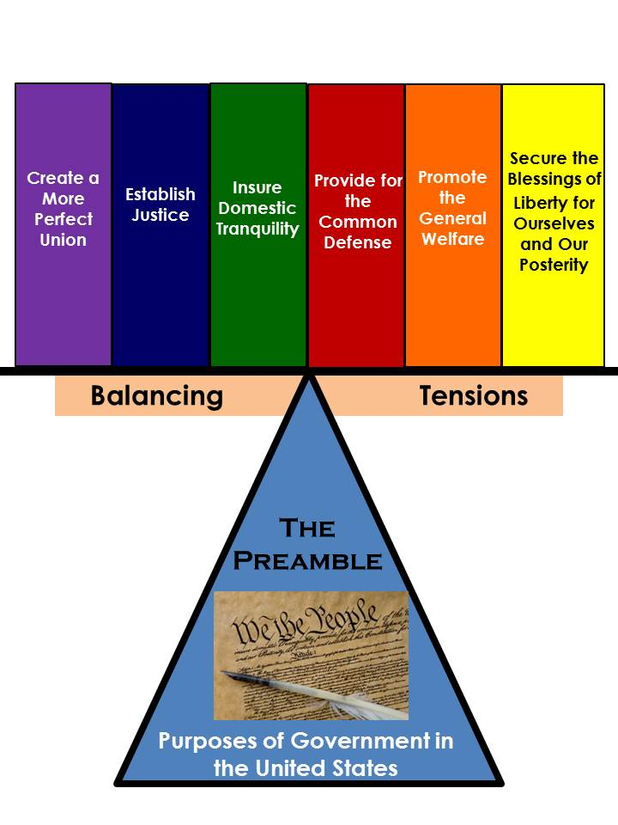
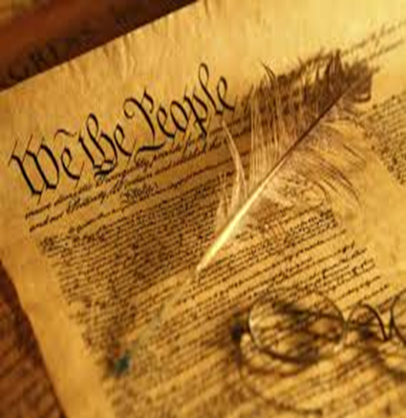
Preamble to the United States Constitution
4

Slide 5
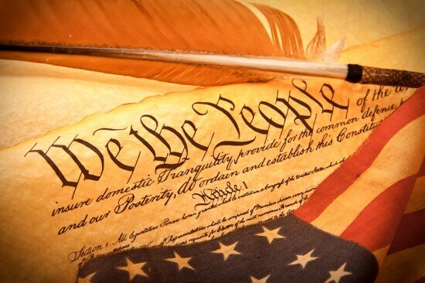
Preamble to the Constitution of the United States
“We the People of the United States… do ordain and establish this Constitution for the United States of America.”

Slide 6
George Washington on the Constitution
“The basis of our political system is the right of the people to make and to alter their constitutions of government. . . . the Constitution which at any time exists . . . is sacred and obligatory upon all. The very idea of the power of and the right of the people to establish government presupposes the duty of every individual to obey the established government.”
6
-- George Washington’s Farewell Address

Slide 7
Constitutional Mechanisms
Written Constitution with Delegated Powers
Separation of Powers
Representative Government/ Republicanism
Federalism
Checks and Balances
Amendment Process
Bill of Rights
7

Slide 8
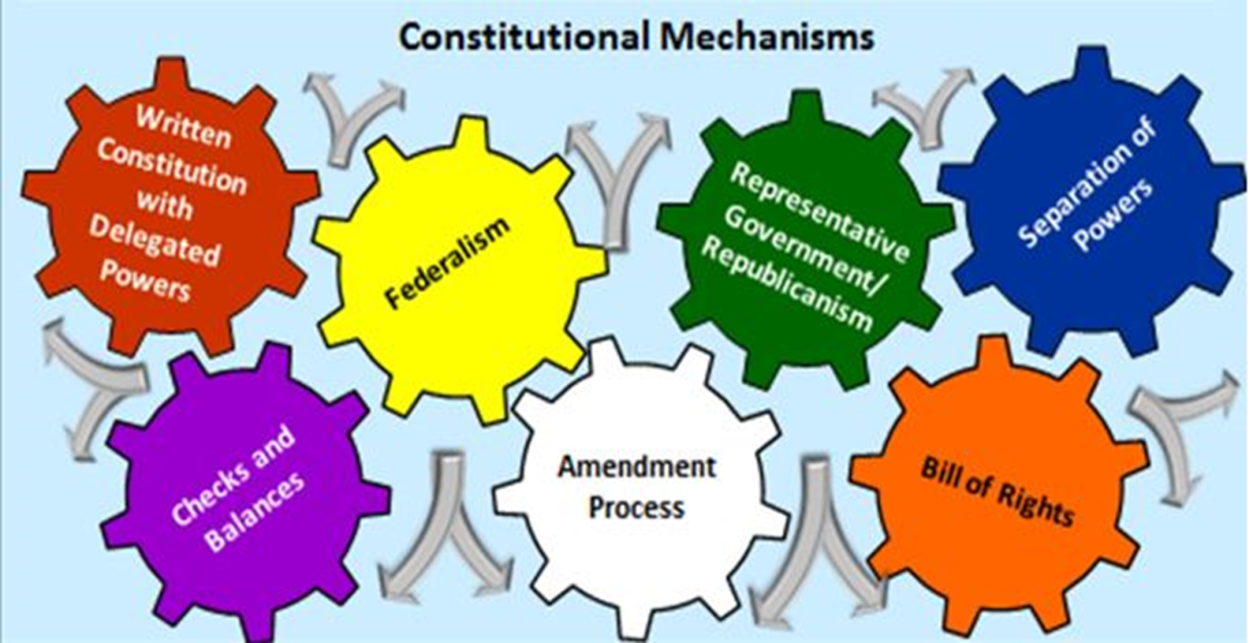
Conflict in our Constitutional System is Not a Bug, It is a Feature!
Conflict between political actors is the norm!
8
Notes:
The goal of constitutions is to manage conflict within acceptable bounds.

Slide 9
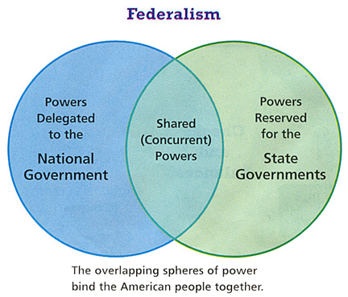
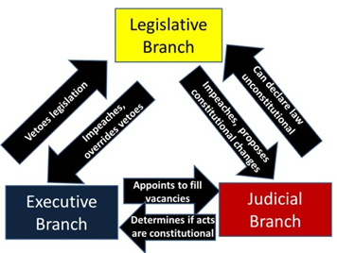
Separation of Powers
Checks and Balances
Federalism
9

Slide 10
Are we a democracy or a republic?
Democracy Defined
A form of government in which power is vested in the people, who rule either directly or through freely elected representatives.
Republic Defined
A form of government in which power is vested in the people, who in turn exercise their power through elected representatives.
Turn and Talk:
1. What is the difference between these two forms of government?
2. What form of government do we have in the United States?
10

Slide 11
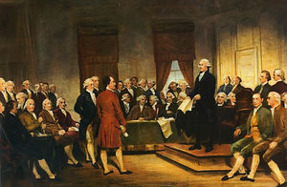
The Constitution of the United States (Article I, Section 4, Paragraph 1)
“The Times, Places and Manner of holding Elections for Senators and Representatives, shall be prescribed in each State by the Legislature thereof; but the Congress may at any time by Law make or alter such Regulations, except as to the Places of chusing Senators.”
Discussion Questions
1. What type of source is this?
(primary or secondary)
2. What is the central idea of the quote?
11

Slide 12
“We hold these truths to be self-evident, that all men are created equal, that they are endowed by their Creator with certain unalienable Rights, that among these are Life, Liberty and the pursuit of Happiness.--That to secure these rights, Governments are instituted among Men, deriving their just powers from the consent of the governed…”
-The Declaration of Independence
“We the People of the United States… do ordain and establish this Constitution for the United States of America.”
- Preamble to the U.S. Constitution
1. Does there seem to be any conflict between these 3 quotes?
2. Do the people get to set the rules for their elections?
“The Times, Places and Manner of holding Elections for Senators and Representatives, shall be prescribed in each State by the Legislature thereof; but the Congress may at any time by Law make or alter such Regulations, except as to the Places of chusing Senators.”
- Article I, section 4, paragraph 1

Slide 13
Team Orange vs. Team Green
Team ORANGE = All “O” students agree
Team GREEN = All “G” students agree
40 votes will be divided into 5 districts
These 40 people will end up with 5 votes in the House of Representatives!

Slide 14
Choice #1
O | O | O
O | O
G | G | G
O | O | O
O | O | O
G | G
O | O | O
O | O
G | G | G
O | O
O | O
G | G
G | G | G | G | G | G | G | G | G | G
How many students favor choice #1
Notes:
Show only choice #1 and choice #2. Ask how many students favor choice #1 (all of the Orange group should raise their hands). Then, ask how many students favor choice #2 (all of the Green group should raise their hands). Have a very brief discussion making sure to point out that the Orange group would get 4 votes and the Green group would get 1 under choice #1 and vice versa under choice #2. You may have some students who do not go along with their group. Discuss why they disagree with the expected, advantageous choice for them. Keep this discussion brief as a longer discussion will be forthcoming. Tell students that these are very real possibilities that happen in states today.

Slide 15
Choice #2
O | O | O
G | G
G | G | G
O | O | O
G | G | G
G | G | G
O | O | O
G | G
G | G | G
O | O
G | G
G | G
O | O | O | O | O | O | O | O | O | O
How many students favor choice #2

Slide 16
Choice #3
O | O
O | O
G | G
G | G
O | O
O | O
G | G
G | G
O | O
O | O
G | G
G | G
O | O
O | O
G | G
G | G
O | O
O | O
G | G
G | G
How many students favor choice #3
Notes:
Then show them choice #3 and ask what they think. It should come out in this short discussion that choice #3 is even. Probe students’ thinking – ask students whether they prefer to keep score and win in a competition or whether they would prefer to not keep score and just play.

Slide 17
Team GREEN is in POWER
3 green students and 2 orange students will VOTE on how to divide districts.
Team GREEN…
What will you pick?
Choice #1, #2, #3
Notes:
Tell the Green group they are currently in power in the legislature. They have 3 legislators and the Orange group has 2. Pick 3 students from the Green group and 2 students from the group Orange to come to the front of the class and to act as those legislators. For purposes of this simulation, it might be helpful to pick more competitive students as legislators (representatives). Now tell them that the 5 of them will vote on redrawing the districts. They can choose any of the three choices from Teacher Reference Sheet 2: Disparate Districts. What should transpire is that choice #2 is selected. Point out to students that in the future it is very likely that the Green group would end up with 4 representatives and the Orange group would drop to 1, regardless of the number of voters in the class. Next, take a POLL (NOT a VOTE) on whether the citizens in your class are happy with the outcome. It should show that the members of the group Orange are unhappy for the most part and that members of the group Green are thrilled. Now ask the class when this would likely change. Direct them to see that as long as the Green group has the power, they will likely seek to maintain it.

Slide 18
Census Clause in the U.S. Constitution
“Representatives and direct Taxes shall be apportioned among the several States which may be included within this Union, according to their respective Numbers…The actual Enumeration shall be made within three Years after the first Meeting of the Congress of the United States, and within every subsequent Term of ten Years, in such Manner as they shall by Law direct.”
-United States Constitution, Article I, Section 2, Paragraph 3

Slide 20
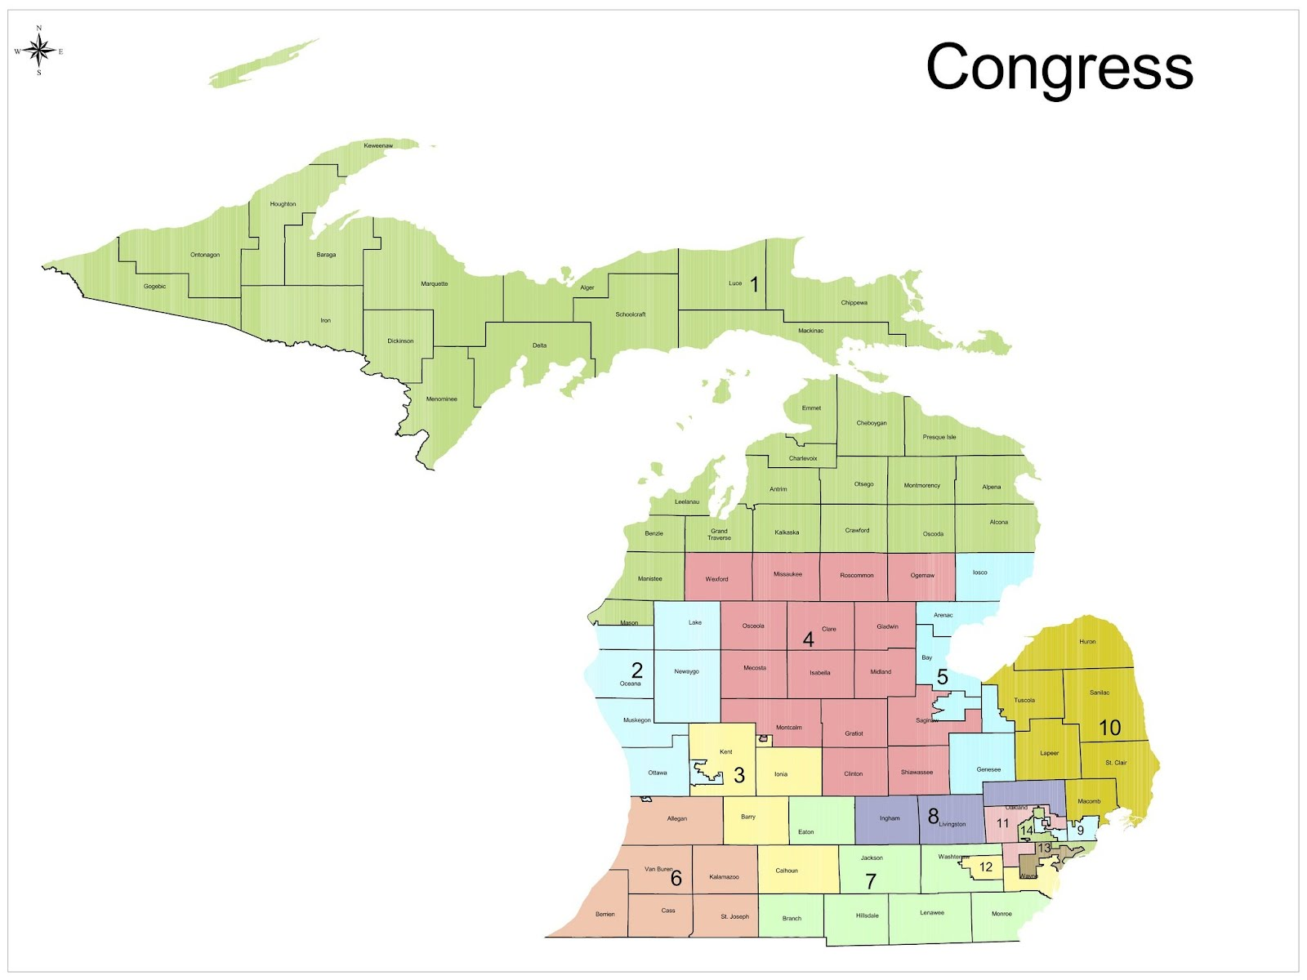
Michigan Congressional
Districts
Notes:
Governor Rick Snyder signed legislation that sets new congressional district boundaries. The maps were designed and passed by the Republican legislature earlier this year [2011].
http://michiganradio.org/post/politics-michigans-redistricting-plan#stream/0

Slide 21
Small Group Discussion Questions
What do you notice?
To what extent does this map represent the idea of representative government (republicanism)?
In looking at the chart of the political parties (Democrats and Republicans) on page 2, what do you notice?
21

Slide 22
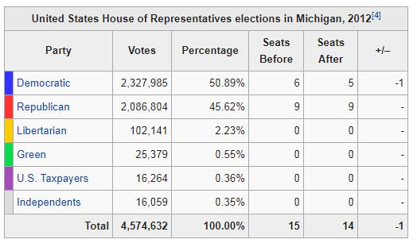

Slide 23
Is Gerrymandering a Threat to Our System of Government?
Turn and Talk:
Make a claim!
Use evidence from Student Handouts 3 and 4.
Discuss how the evidence supports your claim.

Slide 24
 | Claim State your position on the issue: Is gerrymandering a threat to our system of government? Why or why not?
 | Evidence Use factual information to support your claim. (Facts, examples, constitutional principles, founding documents, etc.)
 | Reasoning Connect your evidence to your claim by explaining your thinking.
 | Conclusion Restate your claim, summarizing your overall argument.

Slide 25
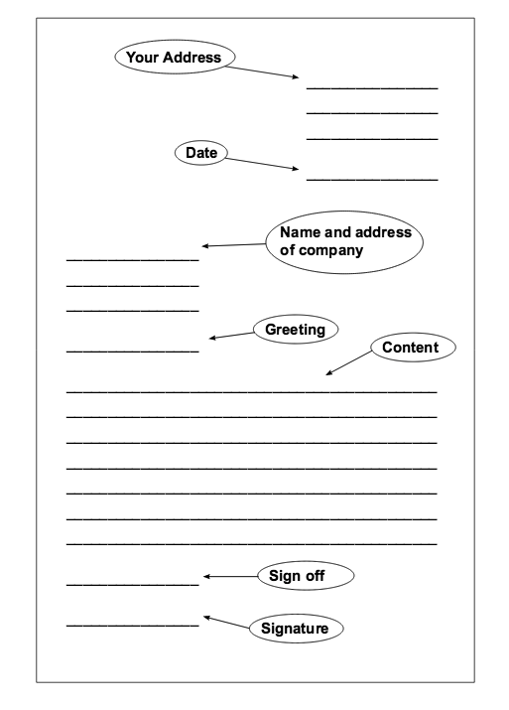
Formal
letter writing
format

