Slide 1
Unit 3 Lesson 8
The Human Story Outside of Afroeurasia -
Historical Patterns in Different World Zones

Slide 2
Turn and Talk:
If we have been focusing on Afroeurasia… what do you think are the other areas of the world and what was happening in those places during Era 2?
Do you think there were people living in these areas, and if so, how do you think they lived?

Slide 3
World Zones:
“Large regions within which there were connections between human communities, but between which connections were so sporadic (didn’t happen a lot) that they don't really count.”
In other words, world zones are areas that have lots of movement and interaction among the people who live there, but they are not connected to other world zones (the people in one zone generally did not have any contact with people in other zones).

Slide 4
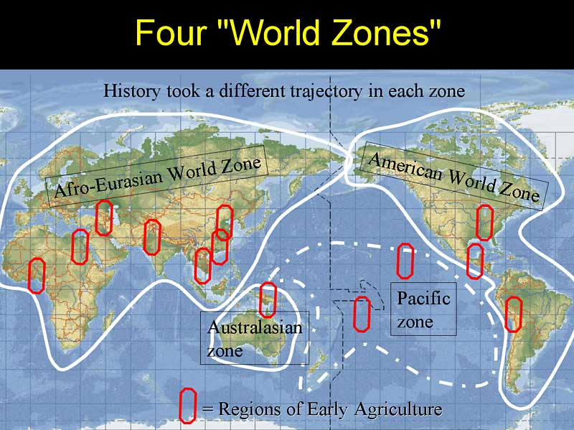
One idea about our World Zones….
http://www.historycooperative.org/journals/whc/5.2/christian.html

Slide 5
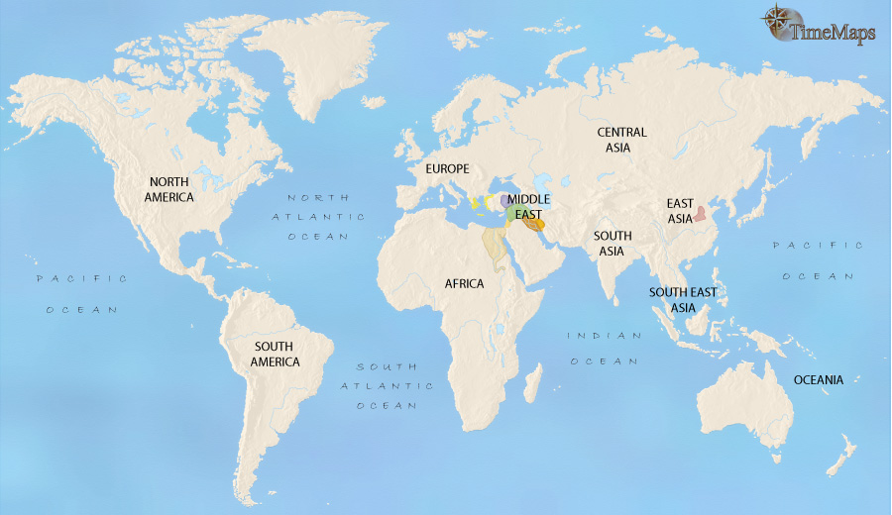
Another idea about world zones in Era 2
The Americas
Afroeurasia
Sub-Saharan
Africa
Oceania
Turn and Talk: What geographic features separate each world zone? What would have prevented people from one zone from having contact with people in another zone?

Slide 6
Predicting similarities and differences:
Stop and Jot:
Make your own version of the table below. For each world zone (the Americas, Sub-Saharan Africa, Afroeurasia, and Oceania) jot down your best guess as to how people lived there during Era 2. Make a prediction for each of the questions below and briefly explain your thinking. You will turn this in and re-visit it later.
During Era 2: | How did they get their food? | What technologies did they have? | How did they live? Small groups or big towns?
Afroeurasia
The Americas
Oceania
Sub-Saharan Africa

Slide 7
Exploring life in these world zones during Era 2 Where would you have wanted to live?

Slide 8
Student Handout 1: World Zone Checklist
BCE | 3500 | 2500 | 1500 | 1000 | Does it exist in this zone at this time?
Afroeurasia |  |  |  |  | Foraging
 |  |  |  |  | Pastoral nomadism
 |  |  |  |  | Small-scale Farming / Sedentism (small villages)
 |  |  |  |  | Large-scale Farming / Cities
 |  |  |  |  | Metallurgy and metal tools
 |  |  |  |  | Kingdoms/empires
The Americas |  |  |  |  | Foraging
 |  |  |  |  | Pastoral Nomadism
 |  |  |  |  | Small-scale Farming / Sedentism (small villages)
 |  |  |  |  | Large-scale Farming / Cities
 |  |  |  |  | Metallurgy and metal tools
 |  |  |  |  | Kingdoms/empires
Sub-Saharan Africa |  |  |  |  | Foraging
 |  |  |  |  | Pastoral Nomadism
 |  |  |  |  | Small-scale Farming / Sedentism (small villages)
 |  |  |  |  | Large-scale Farming / Cities
 |  |  |  |  | Metallurgy and metal tools
 |  |  |  |  | Kingdoms/empires
Oceania |  |  |  |  | Foraging
 |  |  |  |  | Pastoral Nomadism
 |  |  |  |  | Small-scale Farming / Sedentism (small villages)
 |  |  |  |  | Large-scale Farming / Cities
 |  |  |  |  | Metallurgy and metal tools
 |  |  |  |  | Kingdoms/empires

Slide 9
Pastoral nomadism | People who live by herding larger mammals, moving from place to place to find new pastures.
Small-scale Farming / Sedentism (small villages) | Small villages with some farming, but also some foraging. They have enough food available so that they don’t have to move around, but not enough to support a large population.
Large-scale Farming / Cities | Cities with possibly thousands of people, made possible because there is enough agriculture to allow for surpluses of food. Not everyone has to farm and many people specialize in other areas.
Metallurgy | The knowledge of how to mine, process, and use metals for tools, weapons, and jewelry. Bronze was the first highly useful metal for tools and weapons.
Kingdoms/empires | Societies with agricultural surpluses, cities, and centralized governments ruled by some sort of king. They often expanded and tried to rule other areas through force, but also traded with other kingdoms.

Slide 10
A Global Snapshot: 3500 BCE
Afroeurasia:
Stone Age farmers and hunter-gatherers inhabit large sections of Asia and Europe. Yet farming is well-established in the two great river valleys of China, and is spreading to neighboring lands. The first civilizations in world history, those of Mesopotamia and Ancient Egypt, are emerging with large cities. This is the largest and most complex world zone at this time, and it is also the most densely populated. Bronze technologies develop and spread across the region. Pastoral nomadism develops in the steppes.
The Americas:
Hunter-gatherer cultures cover most of North America, while permanent villages have grown up along coasts and rivers in South America with some limited agriculture. Metallurgy is not widely practice.
Sub-Saharan Africa: This zone is inhabited mainly by small groups of hunter-gatherers, many of them nomadic. Metallurgy had not yet emerged.
Oceania:
All the Pacific islands are uninhabited, except for Australia, New Guinea and the Solomons. People in those places live in small villages, fishing and foraging, with some small scale agriculture (horticulture). Metallurgy had not yet emerged.
Based on information from worldhistoryforusall.sdsu.edu/, David Christian’s Maps of Time, and www.timemaps.com.

Slide 11
A Global Snapshot: 2500 BCE
Afroeurasia:
The civilizations of Egypt and Mesopotamia are now flourishing in the Middle East.
Europe is still inhabited by Stone Age farming peoples, but agriculture and bronze technologies are spreading. One of the great civilizations of the Ancient World has emerged in the Indus Valley. Agriculture is spreading out from its core areas in northern and southern China. Pastoral nomads sometimes clash with farming kingdoms.
Based on info. from worldhistoryforusall.sdsu.edu/, David Christian’s Maps of Time, and www.timemaps.com.
The Americas
Small-scale farming, based on maize as the staple crop, is beginning to spread northwards from present-day Mexico - though nowhere is it the primary source of food, and elsewhere in North America hunter-gatherer cultures prevail. Large villages are developing along the Pacific coast, with temple-mounds and irrigation systems being constructed. Larger scale agriculture is emerging there. Metallurgy is not widely practiced.
Sub-Saharan Africa:
Cattle-herding populations are now ranged over a vast swathe of territory, stretching from modern-day Sudan into West Africa. On the rest of the continent live hunter-gatherer peoples and fishermen, mostly related to today’s Pygmies or San Bushmen. Metallurgy has not yet emerged.
Oceania:
People in this zone practice small-scale agriculture. Navigation and fishing technologies are advanced and most people live either as nomadic foragers in small villages. The migration of the ancestors of the Polynesians has begun from south China into the Pacific islands. Metallurgy has not yet emerged.

Slide 12
A Global Snapshot: 1500 BCE
Afroeurasia:
A number of the greatest civilizations of the Ancient World now jostle each other in the Middle East - including those of Egypt, Assyria, the Hittites, and Babylon. The Chinese civilization during the Shang dynasty has become even more complex and organized. It has already developed superb bronze-making techniques. The first European civilizations, the Minoan in Crete and the Mycenean in Greece, are thriving. Pastoral nomad societies have also flourished and engage in both trade and conflict with these civilizations.
The Americas:
Farming based on maize continues to spread in North America. In present-day Mexico, farming has now become firmly established as the predominant way of life. Several distinct farming cultures are developing in different areas. The people of the Pacific coast of South America are, by this date, already making strides towards true civilization, as larger and more complex societies begin to emerge. Towns have appeared in the river valleys, dependent upon irrigation farming for their sustenance. Metallurgy is not widely practiced.
Sub-Saharan Africa:
In a vast area stretching from the present-day Sudan into West Africa and down into East Africa, semi-nomadic populations of cattle herders occupy the land. Probably by this date, however, a crucial breakthrough has been made. Somewhere within this huge territory the domestication of sorghum and millet has occurred. Farming is therefore beginning, but still on a small scale. Many people still live as foragers in this area and metallurgy is not practiced.
Oceania:
Groups of migrant people have now settled the coasts and islands of the Philippines and points south to the northern coast of New Guinea, and as far east as the Solomon islands. At about this time they also embark on the first of their great colonizing ventures, when a group of them sail the 2500 km (1550 miles) eastwards across open water to settled the Mariana islands. People still generally live from small-scale farming, fishing, and foraging and do not have access to metals.
Based on information from worldhistoryforusall.sdsu.edu/, David Christian’s Maps of Time, and www.timemaps.com.

Slide 13
A Global Snapshot: 1000 BCE
Afroeurasia:
Invasions, including several by pastoral nomad groups, have devastated the old centers of civilization, but important new developments, such as the use of iron, the appearance of the alphabet and the rise of Israel, with its monotheistic religion, have taken place. Major population movements in Europe have caused widespread upheaval, and the Minoan and Mycenaean civilizations have vanished. Chinese civilization expands under the Zhou dynasty and controls even more territory. Agriculture is firmly established in most of the zone.
The Americas
In present-day Mexico and neighboring areas, regional farming cultures are flourishing, and amongst them, the first civilization of North America has appeared with the Olmecs. The Olmecs develop large-scale agriculture, monumental architecture, and a large capital city. Most peoples of present-day USA and Canada still live as hunter-gatherers. However, even at this early date irrigation farming is present in the arid South West. In the highlands of Peru the first South American civilization has appeared, the Chavin civilization. Its influence extends over a wide area, taking in both coastal and mountain environments. Metal working has begun in the Andes, but metal is used primarily for art and jewelry and less so for tools and weapons.
Sub-Saharan Africa:
Cattle-herding and farming are gradually spreading throughout western and central Africa, having probably reached the Great Lakes region by now. Also, around this date, some peoples in West Africa, living on the fringes of the rain forests, are making the difficult transition to forest farming. This agriculture is based on a quite different set of crops to savannah agriculture, with cultivated fruits and roots such as plantains and yams as the staples. Throughout the greater part of central and southern Africa, people remain hunter-gatherers and fishermen. Metallurgy may have been emerging, but still not widely used.
Oceania:
In Australia, larger, more stable tribes of foragers join together to secure food sources in the drier conditions. Migrant groups continue to move eastwards, reaching Fiji by 1300 BC and Tonga and Samoa by 1000 BC. They carry with them their cultural package known as the "Lapita culture," marked in the archaeological record by pottery with distinctive decorations based on tattoo designs. This culture was based on a mixed economy of horticulture and maritime subsistence. The people had pigs, dogs and fowl (ducks, chickens). Metallurgy still has not emerged.
Based on information from worldhistoryforusall.sdsu.edu/, David Christian’s Maps of Time, and www.timemaps.com.

Slide 14
Turn and Talk:
What seems to be the larger pattern of difference between the world zones? How are they different from each other?
What would a map of world zones look like for the world today?
How has the world changed?

Slide 15
Afroeurasia-
Large scale agriculture and civilizations with social hierarchies and advanced technologies appear first in this region. Also has large groups of pastoral nomads who clash with agriculture-based kingdoms.
Sub-Saharan Africa-
Farming begins to spread across the region by the end of the era, but most people are pastoral nomads or foragers.
Oceania-
Small groups of expert navigators migrating across the ocean and settling the island
The Americas- Large agricultural civilizations appear by the end of the era, but without bronze and large mammmals
Intensification and growing populations; advancing technologies shared by all zones

Slide 16
Three things that stick out about life in this zone…..
1.
2.
3.
1.
2.
3.
The Americas
Afroeurasia
Sub-Saharan
Africa
Oceania
1.
2.
3.
1.
2.
3.

