Slide 1
Lesson 7: Interaction in Era 2 – Conflict and Cooperation

Slide 2
Driving questions… In Era 2, who was in conflict, who was cooperating, and why?

Slide 3
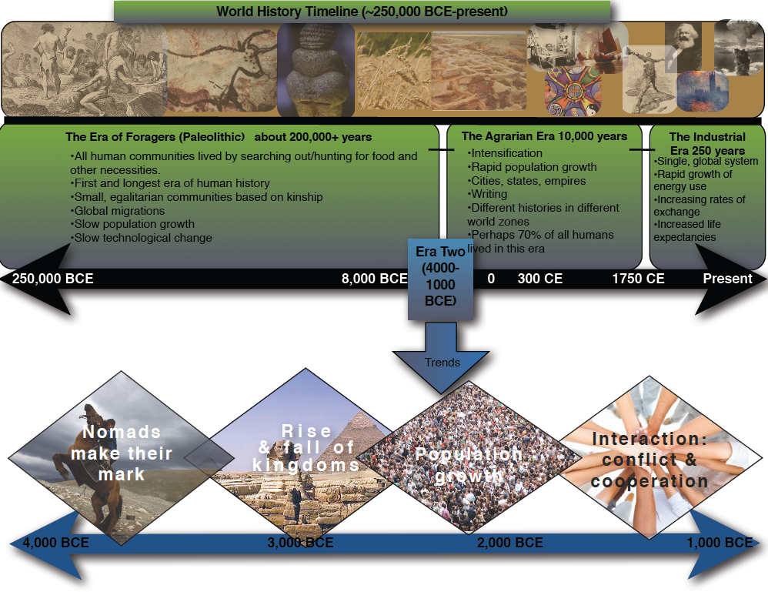
Timeline
Notes:
The top of this timeline shows our Wide Lens view of world history… large patterns over almost all of human history. The bottom zooms in on the patterns of change during Era 2.

Slide 4
Focusing in on Kingdoms…

Slide 5
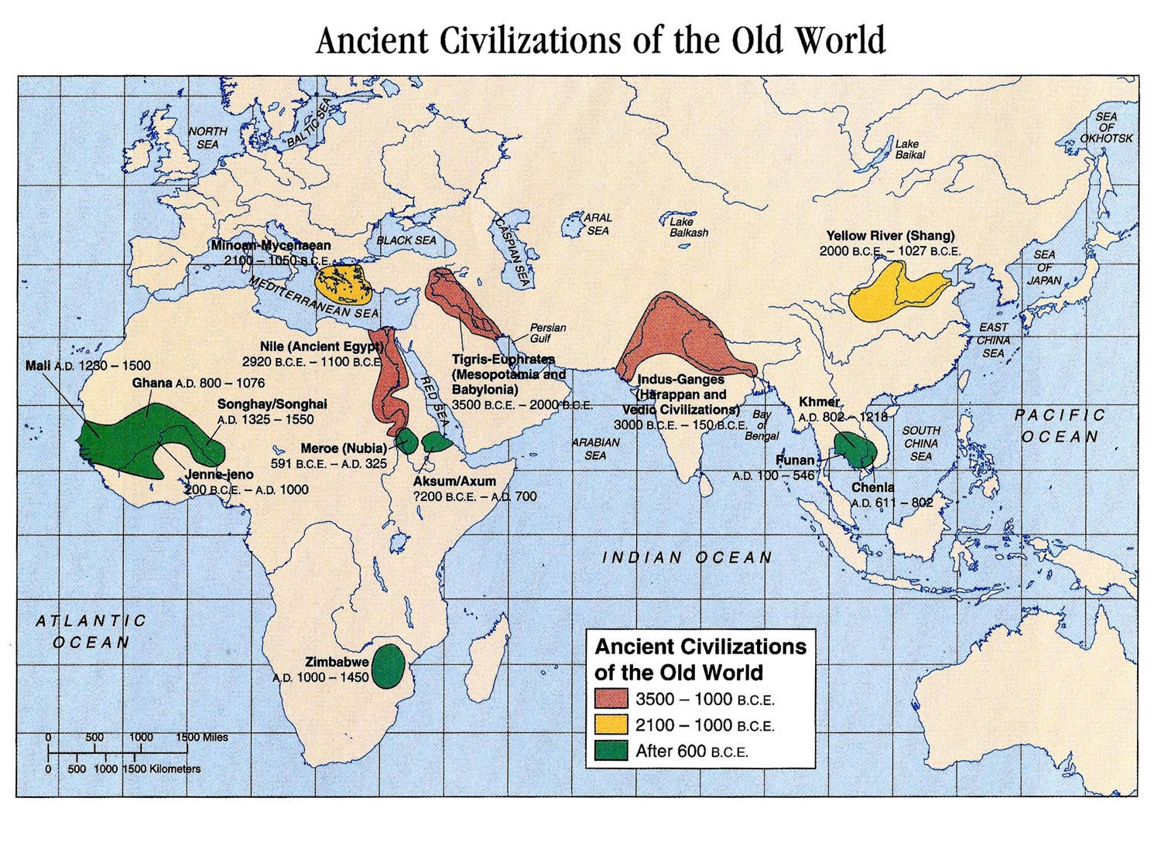
http://qed.princeton.edu/getfile.php?f=Ancient_Civilizations_of_the_Old_World_3500_to_after_600_BCE.jpg

Slide 6
The Shang dynasty in China.
Small kingdoms in the Indus and Ganges valleys of northern India.
The Akkad, Babylonian, Kassite, and Mitanni kingdoms in Mesopotamia (present day Iraq).
The Greek Mycenaean city-states in the Aegean Sea basin.
The Hyksos conquest of Egypt and the later replacement of the Hyksos by the Egyptian New Kingdom.

Slide 7
Kingdoms of this period had these in common:
A monarch (a single, powerful leader)
Central control
Power through force and military leadership
Social hierarchy
Rigid (not easy to move up in)
Military leaders and elites at the top
Religious leaders (priests) also at the top and powerful
Workers and slaves at the bottom
Conflict with nomadic groups, especially in border areas
Growth of large cities as centers of power
Turn and Talk: Even though people had different cultures (language, religions, etc.) in these kingdoms, these kingdoms all shared these features. How do you think this happened? Why did early civilizations get organized this same way?

Slide 8
Focusing in on population:

Slide 9
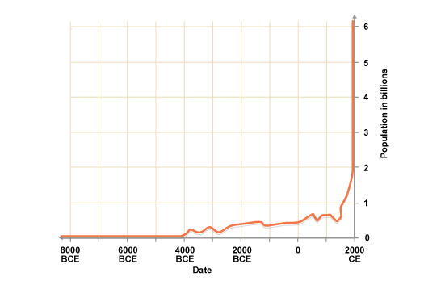
World Population Growth Over Time
http://www.bbc.co.uk/schools/gcsebitesize/science/aqa_pre_2011/evolution/humansrev1.shtml
Era 2
What does the graph show? What is the title?
What does the horizontal axis represent? What does the vertical axis represent?
At what point in time did the biggest change in population take place?
How can you summarize the trends shown by this graph?

Slide 10
Graph
What is the title of the graph?
World Population Growth Over Time
What does the horizontal axis represent?
Passage of time from 8000 BCE to 2000 BCE
What does the vertical axis represent?
Human Population in billions
At what point in time did the biggest change in population take place?
Roughly 250 years ago the line graph goes straight up, around the time of the Industrial Revolution
How can you summarize the trends shown in the graph?
The population grew slowly but steadily during Era 2 but it has exploded in recent time
What was the trend in Era 1?
Little to no growth
What was the trend in Era 2?
Slow but steady growth

Slide 11
Think back to Lesson 6 and the growth of new technologies during Era 2.
Ceramics (pottery)
The plow
Metallurgy… particularly the use of bronze
Textiles
Wheels and wheeled vehicles
What is the connection between more technology and more people?
How does more technology allow for more people, and how do more people create a need for new technology?
Turn and Talk about your ideas, then be ready to share.

Slide 12
The technology feedback loop….
Population growth
Need for more resources
Trade and conflict
Spread of ideas and technologies
New technologies
Where would you put this box and why?

Slide 13
Focusing in on Interactions…

Slide 14
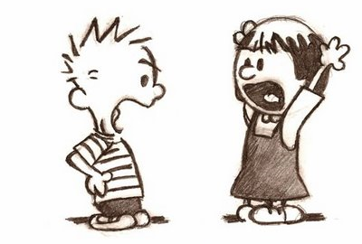
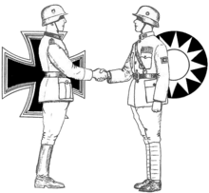
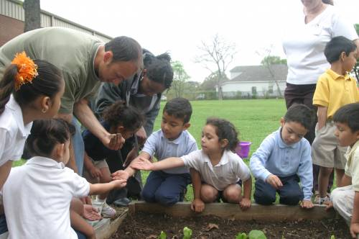
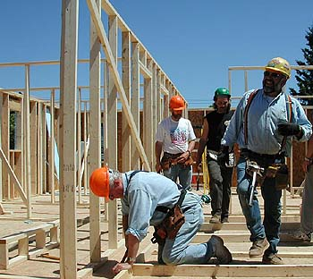
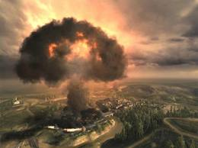
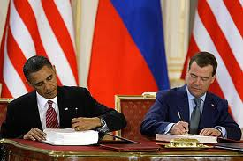
Conflict or
cooperation?

Slide 15
Patterns of interaction…
 | Interaction in Afroeurasia during Era 2
 | Conflict | Cooperation
Within farming societies | Tensions and disputes Slavery Enforced social hierarchy Crime | Specialization Following the rules and norms Trade and commerce… doing business
Across farming societies | War Conquest Tribute (Egypt) | Negotiation and treaties Trade (Uluburun) Technology sharing
Between farming and nomadic societies | Tensions and disputes Raiding and theft Invasion and conquest (Hyksos) | Negotiation Trade Technology sharing

Slide 16
Use the following images and texts that depict the geographic realities of both pastoral nomads and agrarian/settled people to help you think about what each group would want or need from the other.
Consider:
How might settled people and pastoralists cooperate or trade for each other’s benefit?

Slide 17
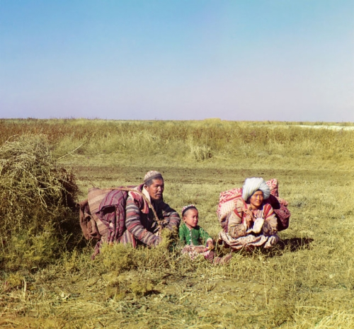
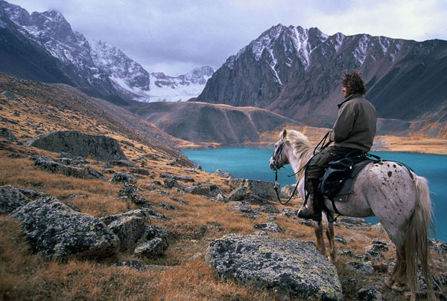
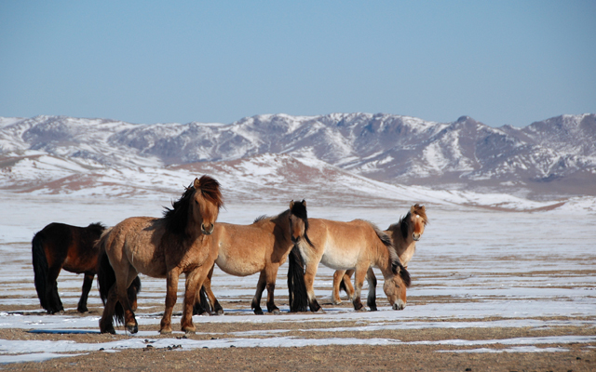
Pastoral Nomads
Life on the Eurasian Steppes
Turn and Talk:
What resources and skills could
nomads offer to agrarian peoples?

Slide 18
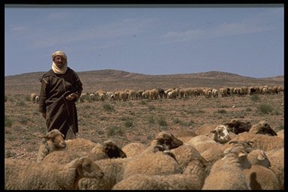
Pastoral Nomads
Turn and Talk:
What resources and skills could nomads offer to agrarian peoples?

Slide 19
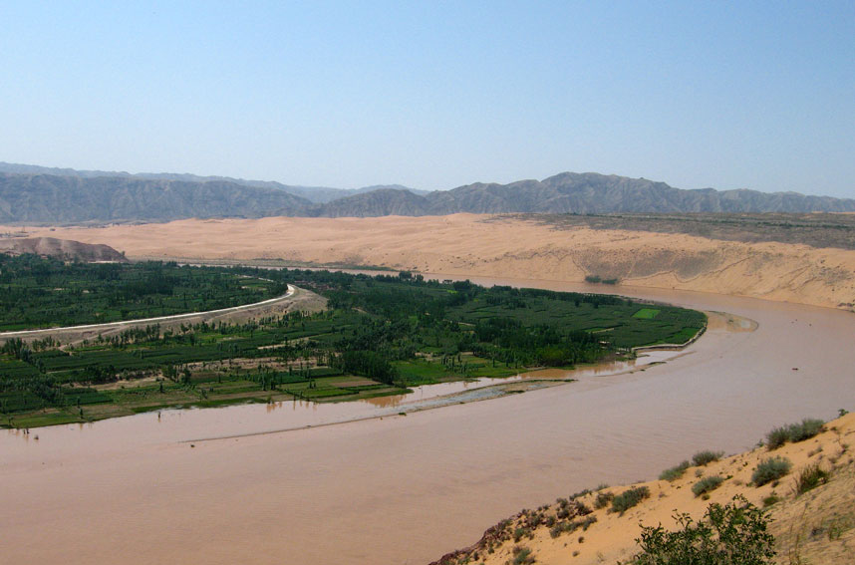
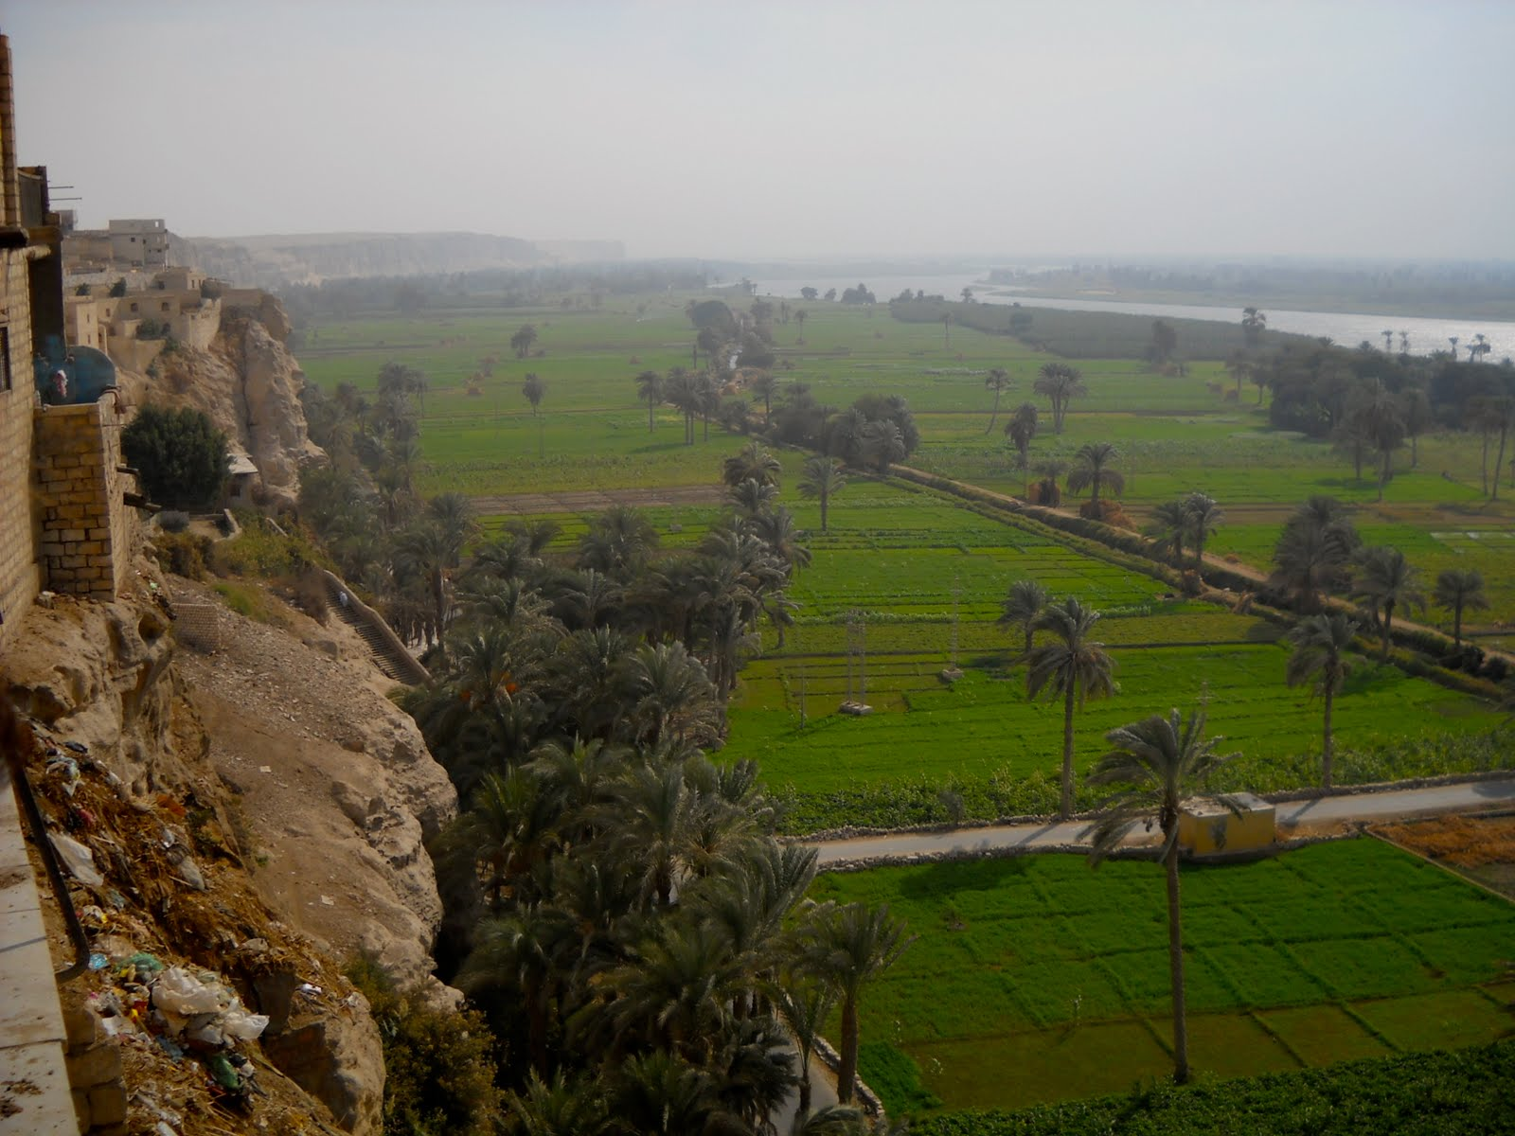
Agrarians/Settled People
Nile Valley
Yellow River--China
Turn and Talk:
What resources and skills could farmers offer to pastoral nomads?

Slide 20
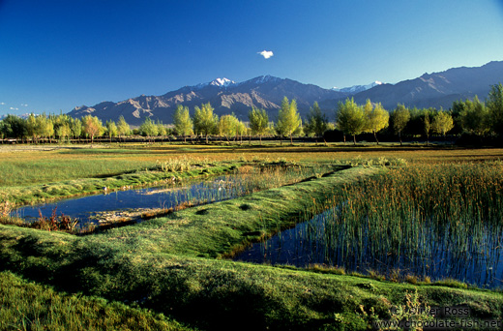
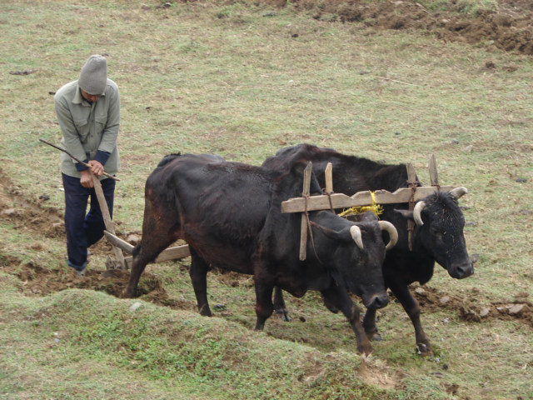
Agrarians/Settled People
Indus Valley
Turn and Talk:
What resources and skills could farmers offer to pastoral nomads?
Using the yoke and plow

Slide 21
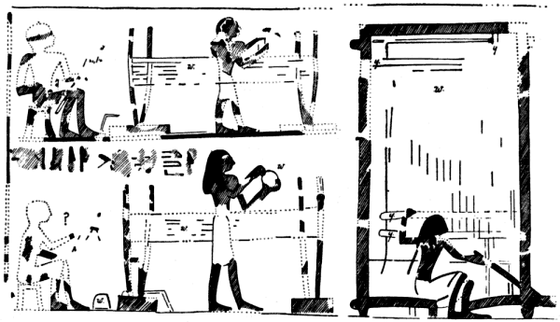
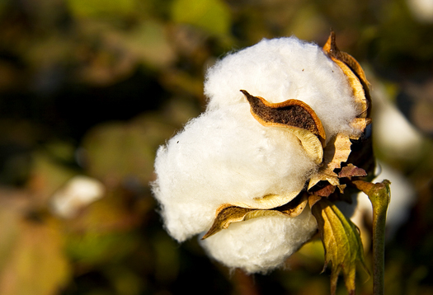
Agrarians/Settled People
Cotton
Weavers at work as represented in the Tomb of Nefer-ronpet,
Turn and Talk:
What resources and skills could farmers offer to pastoral nomads?

Slide 22
Pastoral Nomads & Agrarians
“Pastoral communities usually followed regular migratory routes from pasture to pasture as the seasons changed. When families were on the move, they lived in hide tents or other movable dwellings, and their belongings had to be limited to what they could carry along.
This does not mean that they wished to cut themselves off from farming societies or cities.
Rather, pastoralists eagerly purchased farm produce or manufactures in exchange for their hides, wool, dairy products, and sometimes their services as soldiers and bodyguards. The ecological borders between pastoral societies and town-building populations were usually scenes of lively trade.”
http://worldhistoryforusall.sdsu.edu/eras/era3.php

Slide 23
Pastoral Nomads & Agrarians
Nomads depended for subsistence on the meat and milk of their flocks, but they still needed some agricultural products, such as grain. As a result, pastoral nomadic societies have never been completely independent of farming societies. They have always had to trade, yet in most exchanges they were at a commercial disadvantage.
Nomadism made it impossible to accumulate large surpluses of anything except
live- stock. Pastoral nomads usually needed the grains and the luxury products of agricultural societies more than farmers needed surplus livestock. This unbalanced relationship explains many of the conflicts between farmers and nomads in the borderlands between Inner and Outer Eurasia.
p. 195, David Christian, “Inner Eurasia as a Unit of World History,” Journal of World History, vol. 5, no. 2 (1994).
http://www.uhpress.hawaii.edu/journals/jwh/jwh052p173.pdf
How do these ideas match up to your Turn and Talk ideas after seeing the pictures? Think for a moment and then be ready to share with the class.

Slide 24
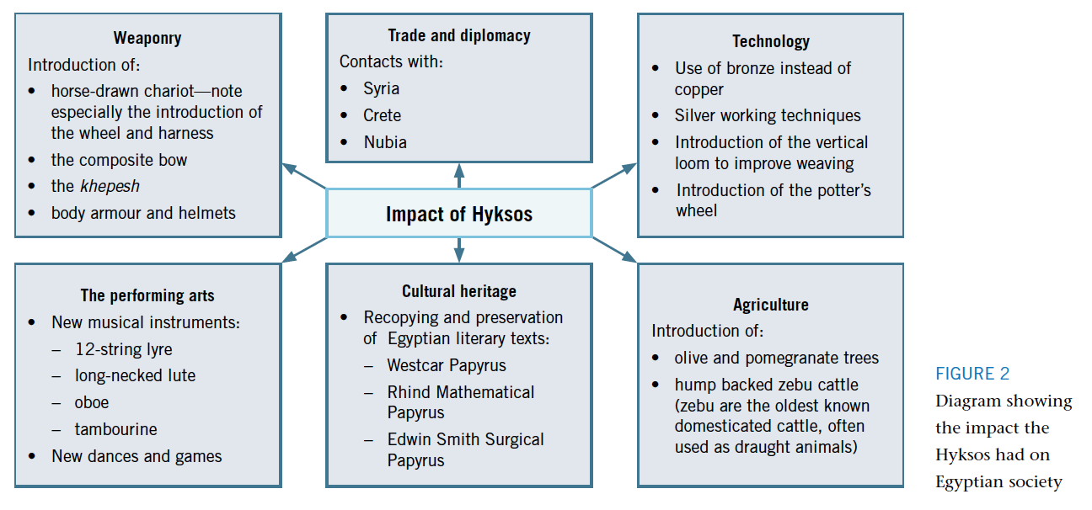
Case study: How conflict can lead to cooperation

Slide 25
Processing patterns of interaction – Exit Slip:
What were the larger patterns of interaction you saw?
Why do you think different groups had conflict sometimes and cooperated at other times?

