Slide 1


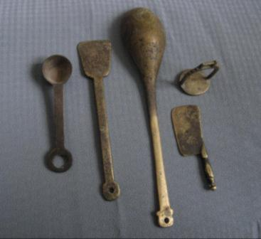
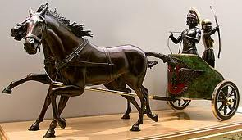
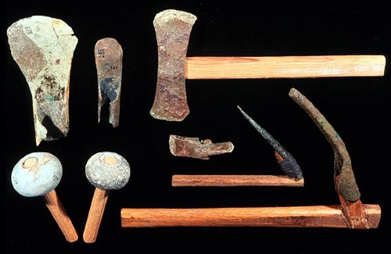
Technological Improvements
Era Two: 4000-1000 BCE

Slide 2
The story of technology…
Watch the video clip: http://www.youtube.com/watch?v=VJILUAWPe20
Stop and Jot, then Turn and Talk:
What does this video make you think of?
What connections can you make to problems and questions we have already studied?
How does the story of technology help tell the story of human history?
What is the role of collective learning (sharing and passing along information) in human history?

Slide 3
What is technology and why does it matter?
Turn and Talk and prepare to share
with these questions:
  What is technology?
  What does “innovation” mean?
  How does technology impact our lives today? Give concrete examples from your life.

Slide 4
How did technology change human societies in Era 2?
Pottery
Plows
Irrigation
• Woven textiles
• Metallurgy
• Wheels and wheeled vehicles
As we go through the PowerPoint, take notes on the History of Technology handout for each type of technology.
  How do you think this technology changed people’s lives?
  How might it have led to other changes in technology?

Slide 5
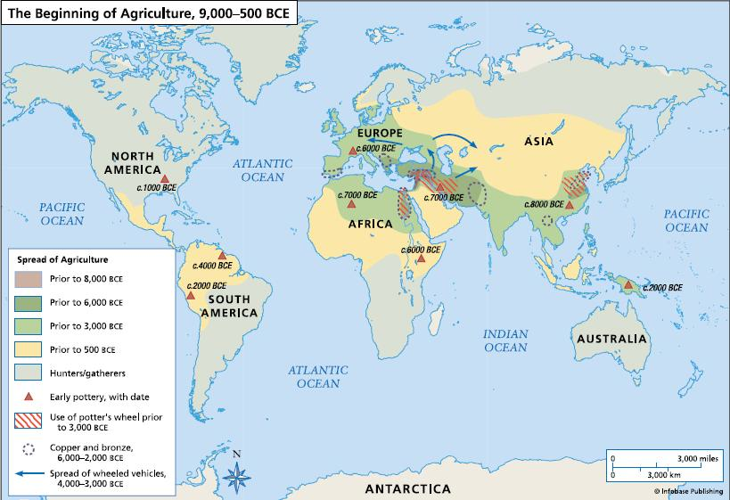
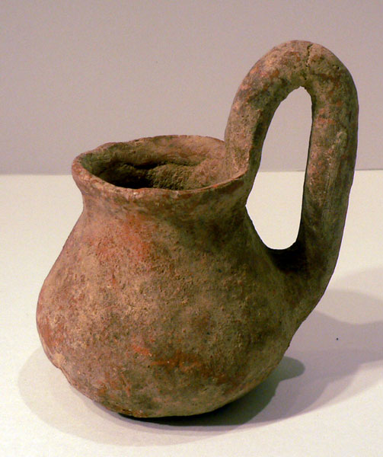
Pottery
Stop and Jot:
What is this map about?
What seems to be the connection between agriculture and pottery?
How do you explain this connection?
What else do you notice?
Notes:
map: http://www.whatisencyclopedia.com/atlas/the-historical-atlas-the-beginning-of-agriculture-9000-500-bce.html
Pot: early bronze-age terracotta jug---Israel

Slide 6
Turn and Talk:
In what ways is a pot a form of technology?
What are the possible uses of a ceramic pot?
What do you think it takes to make a pot?
  What type of knowledge?
  What type of skills?
  What type of resources?

Slide 7
Video clip:
See a woman making the clay & pottery
Watch the video on weebly below the PowerPoint link.
Turn and Talk: “I used to think and now I know”

Slide 8
Turn and Talk:
What do you notice?
What was interesting or surprising?
Do you see anything in this process of making ceramics that relies on modern technology?
Could this have been done 4,000 years ago? What do you think? Why or why not?
Why would someone still make pottery this way today?

Slide 9
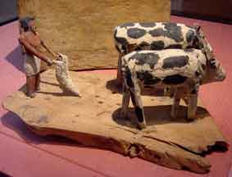
The plow
  How do you think this technology changed people’s lives?
  How might it have led to other changes in technology?
From the Louvre, Paris, France
Notes:
The plow is considered the most important agricultural implement since the beginning of history. It is used to turn and break up soil.
Plowing is the most difficult part of farming. It was especially difficult in Egypt because of the heavy clay soil (which came from the flooding of the Nile). The clay made it difficult to make furrows.
Notice in the picture a man is plowing a furrow with an ox while a woman scatters the seeds behind him. It also depicts the man cutting the grain with a sickle while a woman picks up the cut grain and ties it into bundles.

Slide 10
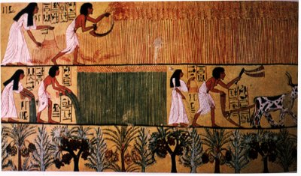
The plow
Stop and Jot:
Describe what you see.
What is a plow and how is it used?
How would it change farming?
What might we learn from these images about gender in ancient Egypt?
From the Louvre, Paris, France

Slide 11
The plow
A plow is used to turn and break up soil.
Plowing is the most difficult part of farming.
It was especially difficult in Egypt because of the heavy clay soil (which came from the flooding of the Nile).
The clay made it difficult to make furrows.
Notice in the picture a man is plowing a furrow with an ox while a woman scatters the seeds behind him. It also depicts the man cutting the grain with a sickle while a woman picks up the cut grain and ties it into bundles.

Slide 12
The Plow
The plow is considered the most important agricultural implement since the beginning of history.
The invention of plow, pulled by animals, made agricultural production vastly more efficient than before, and permitted far more land to be farmed by fewer people
Results:
  A food surplus
  Freed people to do other types of work
  Specialization intensified
  Beginning of a social class system

Slide 13
Irrigation
The supplying water from a source other than rain in order to grow crops.
The artificial application of water to the land or soil.
STOP AND JOT PREDICTION: How do you think this technology changed people’s lives? How might it have led to other changes in technology?

Slide 14
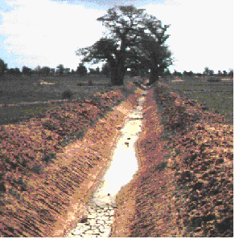
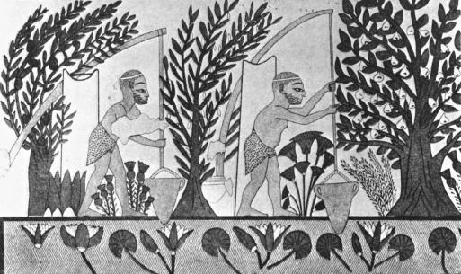
Irrigation
Study these two pictures.
1. Describe what you see.
What is irrigation and what did it do?

Slide 15
Irrigation
(supplying dry land with water… mainly to grow crops)
This frieze (c. 2000 B.C.E.) depicts Egyptians using water from the Nile River for irrigation.
In ancient Egypt, the construction of canals was a major undertaking of the pharaohs and their servants. In many places where fields were too high to receive water from the canals, water was drawn from the canals or the Nile directly by a swape or a shaduf. These consisted of a bucket on the end of a cord that hung from the long end of a pivoted boom, counterweighted. http://www.waterencyclopedia.com/Hy-La/Irrigation-Systems-Ancient.html#ixzz1zl2uGIWm

Slide 16
Irrigation
Early irrigation consisted of the digging of canals to pull water from rivers or lakes into planted fields.
Large scale farming was not possible without irrigation.
Turn and Talk:
What challenges or problems may arise from many people depending on same water supply?

Slide 17
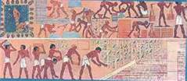
Irrigation
Irrigated agriculture depended on arrangements among people, including farmers, that allowed them to cooperate in maintaining irrigation ditches.
To create larger irrigation projects, such as those along the Tigris-Euphrates and the Nile, large groups of laborers were need.

Slide 18
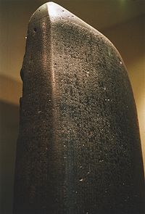
Irrigation
Regulations assured that users along the river would have equal access to the water supply.
Excerpt from Hammurabi’s Code from Babylon (About 1700 BCE):
55. If a man opens a canal for irrigation and neglects it and the water floods a nearby field, he shall pay grain to the owner of the adjacent field.

Slide 19
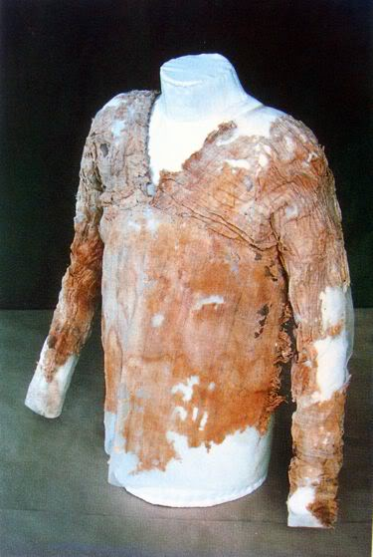
Woven textiles
Textiles:
cloth or fabric that is woven, knitted, or otherwise manufactured
raw material that is used for making fabrics, e.g.- fiber or yarn
Stop and Jot Your Initial Thoughts:
How do you think this technology changed people’s lives?
How might it have led to other changes in technology?
Notes:
Images from: http://threadsofhistory.blogspot.com/2009/08/hunters-and-gatherers.html
Another interesting site on ancient textiles:
http://www.fashionencyclopedia.com/fashion_costume_culture/The-Ancient-World-Mesopotamia/Mesopotamian-Clothing.html

Slide 20
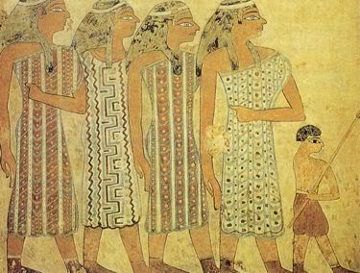
Woven textiles
Study the pictures on this slide.
1991-1786 BCE depiction of Egyptian Aamu people.
Oldest known garment,
from Tarkhan Egypt, ca 3,000 BCE
Turn and Talk:
What do you notice? What catches your interest or attention?
What can we learn about an ancient culture from studying their clothing?
Notes:
Images from: http://threadsofhistory.blogspot.com/2009/08/hunters-and-gatherers.html
Another interesting site on ancient textiles:
http://www.fashionencyclopedia.com/fashion_costume_culture/The-Ancient-World-Mesopotamia/Mesopotamian-Clothing.html

Slide 21
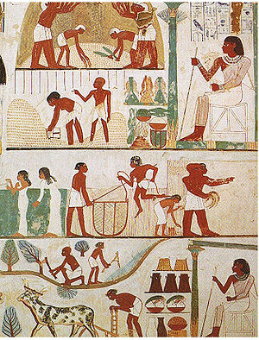
Woven Textiles
Tomb mural from the 15th Century B.C.E.
Social Hierarchy : an order of social classes with producers at the bottom and leaders or kings at the top.
How does this mural help explain social hierarchy in ancient Egypt?
Who do you think is in charge?
How might the clothing provide evidence of social hierarchy in ancient Egyptian society?

Slide 22
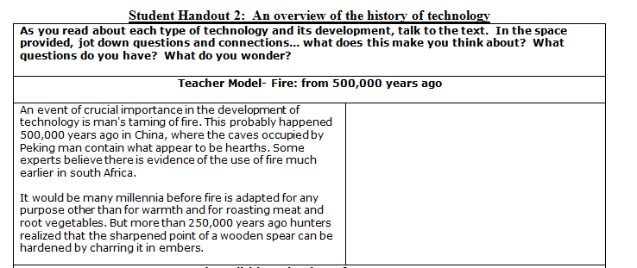
Student Handout 2: teacher modeling and think-aloud

Slide 23
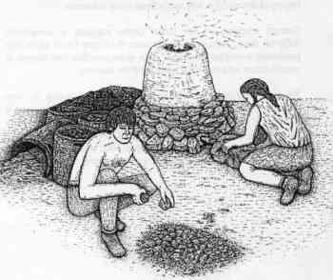
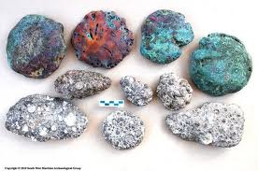
Metallurgy…
The art and science of producing metal goods, all the way from mining and extracting metal from mineral ores to the shaping of metal objects.
Turn and Talk:
Why is it such a big deal that humans learned to make bronze?
Why didn’t foragers figure out how to make bronze?

Slide 24
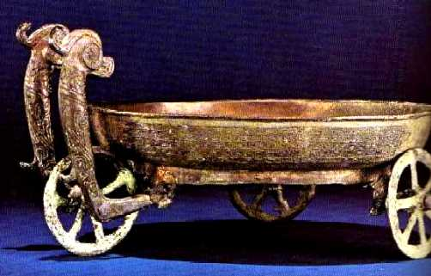
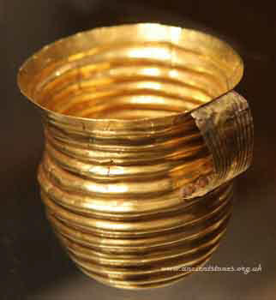
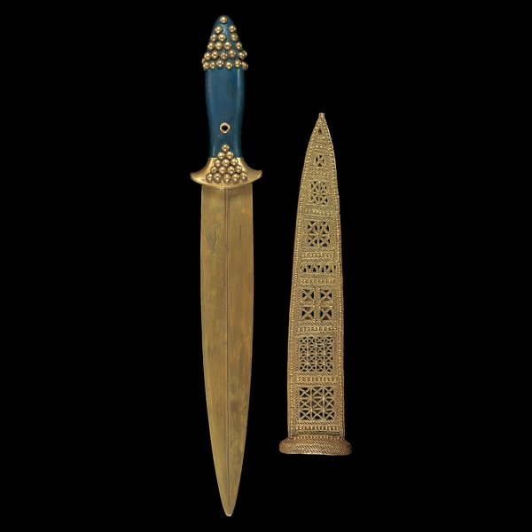
Bronze Age Metal Artifacts…
A unique shallow , bronze basin on three wheels of Eastern Zhou, China (6th - 5th century B.C.E.).
The Rillaton Gold Cup,
Early Bronze Age, 1700-1500 BC
From Rillaton, Cornwall, England
http://www.britishmuseum.org/explore/highlights/highlight_objects/pe_prb/t/the_rillaton_gold_cup.aspx
Stop and Jot:
How are these artifacts evidence of specialization?
What jobs and resources were needed to make them?
Gold dagger with lapis handle and sheath, from Royal Cemetery at Ur, dating circa 2,400 BC
http://sumerianshakespeare.com/media/1ca2d3271aa0f605ffff81b9ffffe417.jpg

Slide 25
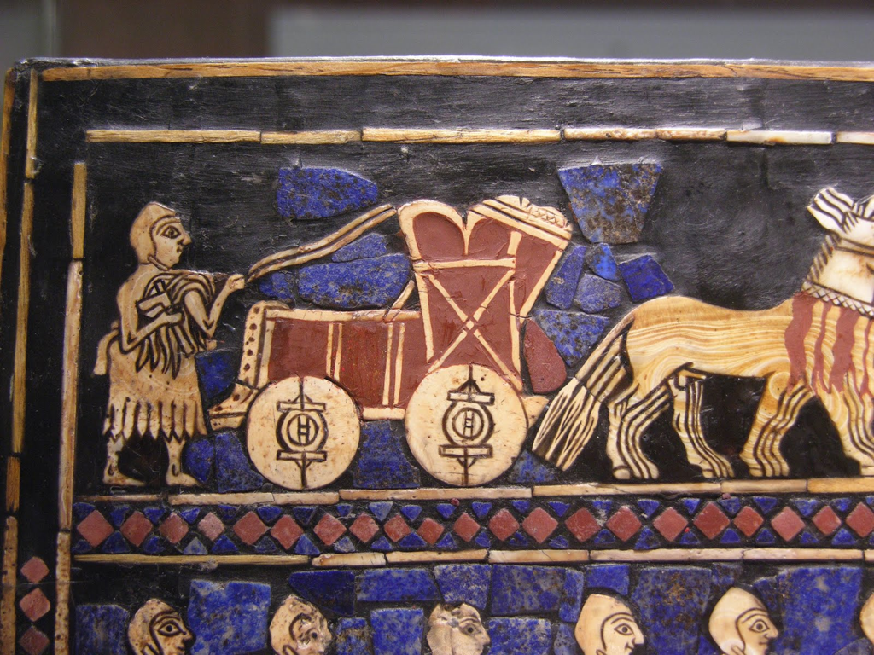
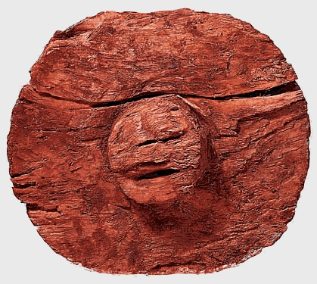
Wheels and wheeled vehicles
Turn and Talk:
In what ways do you think the invention of the wheel changed the lives of people in ancient civilizations?
What tasks would have been easier to do with wheels and wheeled vehicles?
Notes:
wheel: dated around 2700 BCE, Mesopotamia---one of the oldest known wheels

Slide 26
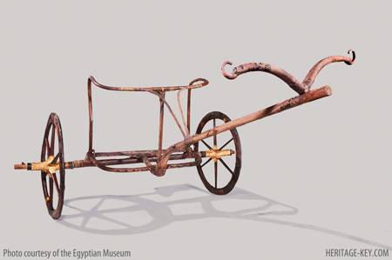
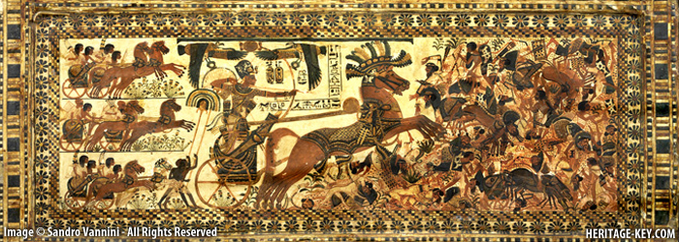
Chariots… Tut’s wheels
Stop and Jot:
What is a chariot?
What made it move?
How do you think King Tut used his?
Notes:
TOP: The Chariot - found in the Antechambre - is unique, in that it does not look like the other chariots found, and does not appear in wall paintings. - Image courtesy of the Egyptian Museum
BOTTOM: The 'Hunting Box', found in kv62, depicts the Boy King driving a war chariot, and personally defeating a heap of Egypt's enemies. - Photo by Sandro Vannini
Tutankhamun's Chariot on its Way to New York City | Heritage Key - Check SITE

Slide 27
Cultural Diffusion…
WHAT IS IT AND WHAT DOES IT HAVE TO WITH TECHNOLOGY?
Culture: The way of life of a group of people… include all of their customs, their food, language, music, etc.
Diffusion: The spreading out of something; something spreading out from a central point
So what is cultural diffusion? With your Turn and Talk partner, take the two definitions above and combine them to create your own definition of cultural diffusion.

Slide 28
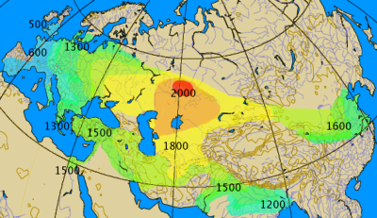
Spread of chariots… BCE
Turn and Talk:
What do you notice? Where was the chariot probably invented?
How long did it take to spread it over Eurasia?
How is the chariot an example of cultural diffusion?
http://www.lasalle.edu/~mcinneshin/wk05/images/NEWChariot_spread.png
Notes:
Also ask, “Where did the chariot NOT spread and why?

Slide 29
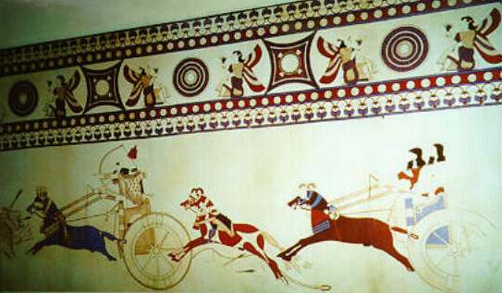
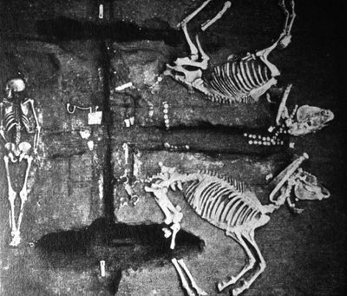
Chariot images… from the Mediterranean to China
Mycenaean Chariots (mid 2nd Millennium)
Turn and Talk:
Why do you think chariots were important?
How did the chariot intensify the speed of cultural diffusion?
China: Shang Dynasty Burial of Horse and Chariots
(1700-1000 BC/BCE)

Slide 30
Thinking about change over time:
Turn and talk with your partner, and then compare ideas with another turn and talk pair on these questions:
How would trade have been different before these technologies? What would have been traded and how? What would people have needed from other places?
How would conflict between groups of people have been different before these technologies? Why and how would people have fought?
So how do you think these technologies (bronze and wheels, for example) changed trade and conflict?
How do you think these technologies changed over the next 1,000 years? Why do you think they changed over time? To what extent are they still important today?

Slide 31
The technology feedback loop….
Need for more resources
Trade and conflict
Spread of ideas and technologies
New technologies

Slide 32
But… so what?
Summary Sheet (exit sheet)
How did these technologies change the way in which people:
    lived?
    worked?
    and interacted?

