Slide 1
early civilizations… The why of the where

Slide 2
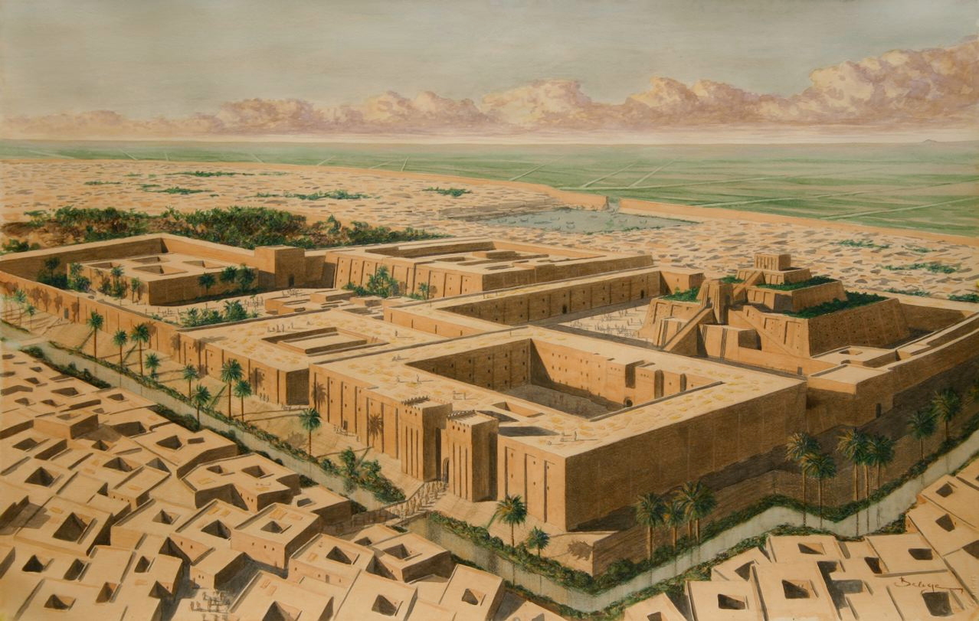
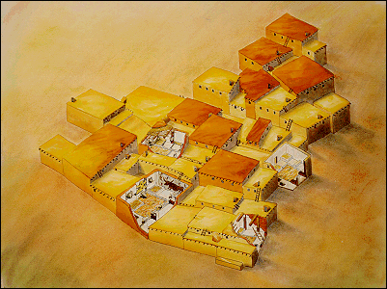
The city of Ur, Sumer (Mesopotamia; present day Iraq)
Catal Hoyuk (in present day Turkey)
What differences do you see between these places? How would life be different in each one? Which one lines up more with your idea of “civilization” and why?

Slide 3
Brainstorming…. What words come to mind when you hear the word civilization?
With your Turn and Talk partner, list out the first several words or images that come to mind.
Where do you think these ideas come from?
Where do we get our ideas of what is “civilized”?

Slide 4
Think-Pair-Share
Does civilization mean better?
Were cavemen civilized?
Is being civilized the same thing as living in a civilization?
Are there communities of people today who are not civilized?

Slide 5
Civilization defined…
The term “civilization” is used to describe larger groups of people living together in one place in more complex societies with social hierarchies and specialization of labor.
During this era, between 4000 and 1000 BCE, this new way of living began to develop in different parts of the world.
Turn and Talk: What do you think the terms “social hierarchies” and “specialization of labor” mean?

Slide 6
Thinking about change…
  How were humans living before civilizations?
  What makes living in a civilization different from living in a foraging community?
  What did you see in the pictures in the opening activity that made you think one place was more of a civilization than another?
  What does a place have to have to be a civilization?
  How did people get food in foraging communities? What about in civilizations?
Foraging Communities | Civilizations

Slide 7
Change over time…..
If one X = 1,000 years, then Era 1 lasted this long:
XXXXXXXXXXXXXXXXXXXXXXXXXXXXXXXXXXXXXXXX
XXXXXXXXXXXXXXXXXXXXXXXXXXXXXXXXXXXXXXXX
XXXXXXXXXXXXXXXXXXXXXXXXXXXXXXXXXXXXXXXX
XXXXXXXXXXXXXXXXXXXXXXXXXXXXXXXXXXXXXXXX
XXXXXXXXXXXXXXXXXXXXXXXXXXXXXXXXXXXXXXXX
Era 2 only lasted this long:
XXX
Why is one Era so much longer than the other?
What makes an Era an Era?

Slide 8
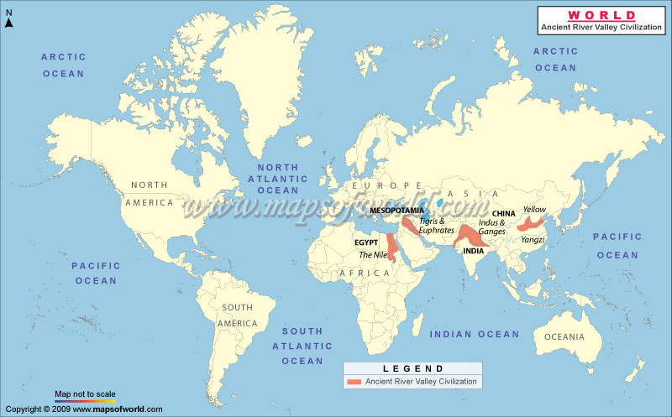
What is this map about? What is it showing you?
How do you know this?
What does it mean that this map is “not to scale?”

Slide 9
Turn and Talk:
Read these two definitions of civilization. With your Turn and Talk partner, discuss how they are both different and similar.
The term “civilization” is used to describe larger groups of people living together in one place in more complex societies with social hierarchies and specialization of labor. During this era, between 4000 and 1000 BCE, this new way of living began to develop in different parts of the world.
A type of society characterized by all or most of the following features: dense population, agricultural economy, cities, complex social hierarchy, complex occupational specialization, centralized state, monumental building, a writing system, and a dominant belief system.
http://worldhistoryforusall.sdsu.edu/shared/glossary.htm

Slide 10
How did people live outside these civilizations?
These were the first civilizations, but they were NOT THE ONLY places people lived.
Think about this definition of civilization:
  a type of society characterized by all or most of the following features: dense population, agricultural economy, cities, complex social hierarchy, complex occupational specialization, centralized state, monumental building, a writing system, and a dominant belief system
http://worldhistoryforusall.sdsu.edu/shared/glossary.htm
Stop and Jot:
With this definition in mind, and using your prior knowledge, how do you think people lived in other places outside of these civilizations?
Be prepared to share your answers and reasoning with the class.

Slide 11
These civilizations were the first to develop in the world (as far as we know).
What do you notice about where they were located? Why do you think that is the case? Stop and Jot and then Turn and Talk.

Slide 12
Geographic Luck
What do you think the term “geographic luck” means?
Working with your Turn and Talk partner, list out some of things you think a place would have if is “geographically lucky.”
Get ready to share your ideas for the class list.

Slide 13
Geographic luck
(According to Jared Diamond)
Jared Diamond’s basic theory is that some countries developed more rapidly than others and were able to expand and conquer much of the world because of geographic luck. The natural resources available to them coupled with the native species and climate provided by their geography led them to become more agricultural and less reliant on hunting and gathering for sustenance.
This agrarian lifestyle, in turn, allowed for the development of “specialists” within the civilization who could work on developing and perfecting the technologies necessary to make these civilizations more profitable, stronger, and more powerful than others around them. Diamond asserts that those living in temperate climates with indigenous animals that could be domesticated were more likely to develop advanced civilizations.
Re-visit your list of predictions about what a geographically lucky place would have. What would you add to your list now?
Notes:
http://www.pbs.org/gunsgermssteel/educators/lesson1.html

Slide 14
How would you complete this graphic organizer?
Geographic Luck
Natural Resources
Native Species
Climate
?
Notes:
Kids should talk about these factors helped some people become more dependent upon agriculture and less so on hunting and gathering. This change allowed people to specialize even more and develop other areas of society… leading to more complex societies and civilizations. Places with more resources and more specialization developed more technology and became more profitable and powerful.

Slide 15
Analyzing geographic luck….
 | Continent and Region | Latitude | Climate Zone | # of Large-seeded grasses | Large mammals for domestication by 1000 BCE
Nile River Valley Civilization
Tigris and Euphrates Civilization
Indus and Ganges Civilization
Yellow River Civilization
Complete these last two with the whole class.
Mississippi River | North America, runs north to south | Approximately 29 – 44 degrees North | Temperate | 4 | 0
Amazon River | South America, runs west to east | Approximately 5 North to 20 degrees South | Tropical | 2 | 0
You will use your copy of this graphic organizer to take notes on as you view the next few slides. Think about the resources available to each civilization.
Pay close attention to the different location names that are used.

Slide 16
Continent and region

Slide 17
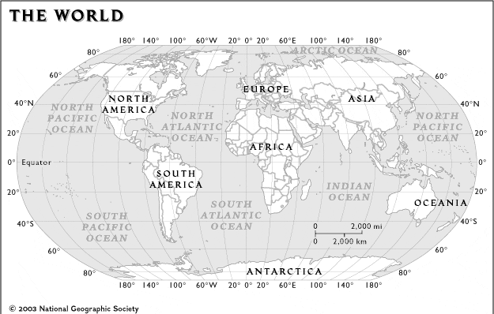
latitude

Slide 18
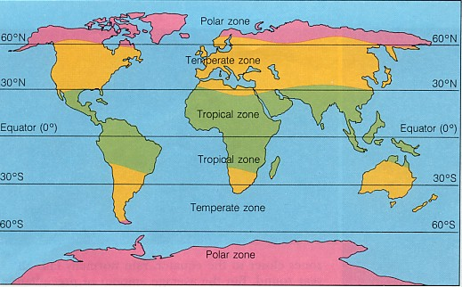
Latitude and climate
Polar- has the coldest with temperatures almost always below freezing.
Temperate- contains most of the Earth’s land masses with more moderate temperatures and rainfall year-round.
Tropical zones- has the warmest average temperatures and gets the most rain.
http://www.webquest.hawaii.edu/kahihi/sciencedictionary/C/climatezone.php
Notes:
Climate Zone: are divisions of the Earth's climates into general climate zones according to average temperatures and average rainfall. The three major climate zones on the Earth are the polar, temperate, and tropical zones. Temperatures in these three climate zones are determined mainly by the location, or latitude, of the zone.

Slide 19
Large-seeded grasses
Region | Number of large-seeded grasses (things like wheat, oats, etc.) | Sub-regions
West Asia, Europe, North Africa | 33 | 32 of the 33 in the Mediterranean zone, 1 in England
East Asia | 6
Sub-Saharan Africa | 4
Americas | 11 | 4 from North America, 5 from Mesoamerica, 2 from South America
Northern Australia | 2
Adapted from Jared Diamond, Guns, Germs, and Steel, p. 140

Slide 20
Large mammals for domestication
Domesticated Animal | Estimated time of domestication | Region where domesticated
Dog | 10,000 BCE | Southwest Asia, China, North America
Sheep | 8000 BCE | Southwest Asia
Goat | 8000 BCE | Southwest Asia
Pig | 8000 BCE | China, Southwest Asia
Cow | 6000 BCE | Southwest Asia, India, North Africa
Llama, alpaca | 3500 BCE | Andes Mountains of South America
Adapted from Jared Diamond, Guns, Germs, and Steel, p. 167

Slide 21
Latitude and climate
What is latitude and why does it matter for civilizations?
What is climate and why does it matter?
How are latitude and climate connected?
Latitude tells us where a place is in relationship to the equator and the poles. In a way, it tells us how much sun a particular place gets, and that tells us something about the climate.
Climate is the general pattern of weather and seasons in a place.
The amount of sun and rain a place gets, and the seasons it has, is important for civilization, because it is important for farming and food production. Can you farm at the North Pole?

Slide 22
Large seeded grasses
What are large seeded grasses and why do they matter for civilizations?
Large seeded grasses are plants like wheat, oats, and barley.
These are plants that people can turn into food, and they have lots of calories.
Because their seeds are large, they are easier to harvest, and people can also store their seeds for a longer time.
Civilization depends upon a stable food source and being able to grow and store more than what is consumed. In other words, in order for lots of people to live together in one place, they need to have lots of food, and they need extra food.
Large seeded grasses were easier to harvest and store than other plants, but not all parts of the world had these types of plants growing.

Slide 23
Large mammals and domestication
What are large mammals, what is domestication, and why do they matter for civilizations?
Domestication is when an entire species or variety of animals is tamed, changed, and managed by people to meet a particular need.
Not all large mammals can be domesticated.
Large mammals suitable for domestication include horses, cows, pig, goats, and sheep. Not all parts of the world had these mammals available.
There are only 14 large mammals in the world suitable for domestication, and the majority of these originated in Eurasia.
These large mammals can be used to carry things, pull things like wagons and plows, provide materials for clothing and tools, and to produce food.
Notes:
The “change” part of domestication happened at the genetic level, over time, through artificial selection and breeding. Dogs provide a clear example. The original dogs were wolves, but people selected dogs to breed over centuries to accentuate different traits like size, thus we have Chihuahuas and Great Danes being the same animal. Cows, for example, were bred over time to be more docile and to produce more milk. This happened when humans selectively bred the cows that were the most calm and produced more milk. Tamed animals, such as a tiger that performs in a circus, is not domesticated. It might allow a trainer to handle it, but the any tiger cubs it has will not inherit trust of humans or the ability to perform… these must be taught. Domestication is inherited, training and taming is not.

Slide 24
Reflection and analysis:
In small groups, discuss each of these questions. Have a recorder write down your group’s answers. Also have a spokesperson who is ready to explain your group’s answers to the class.
What can we add to our original Geographic Luck list now?
What evidence is there that supports Jared Diamond’s theory that early civilizations were geographically lucky?
What is it about rivers? Why did the four first large civilizations emerge around large rivers?
What factors besides rivers seemed important in the development of civilizations?

